Slide 1
POVs, HMWs, & Experience Prototypes
10/08
10/08
Team 2

Slide 2
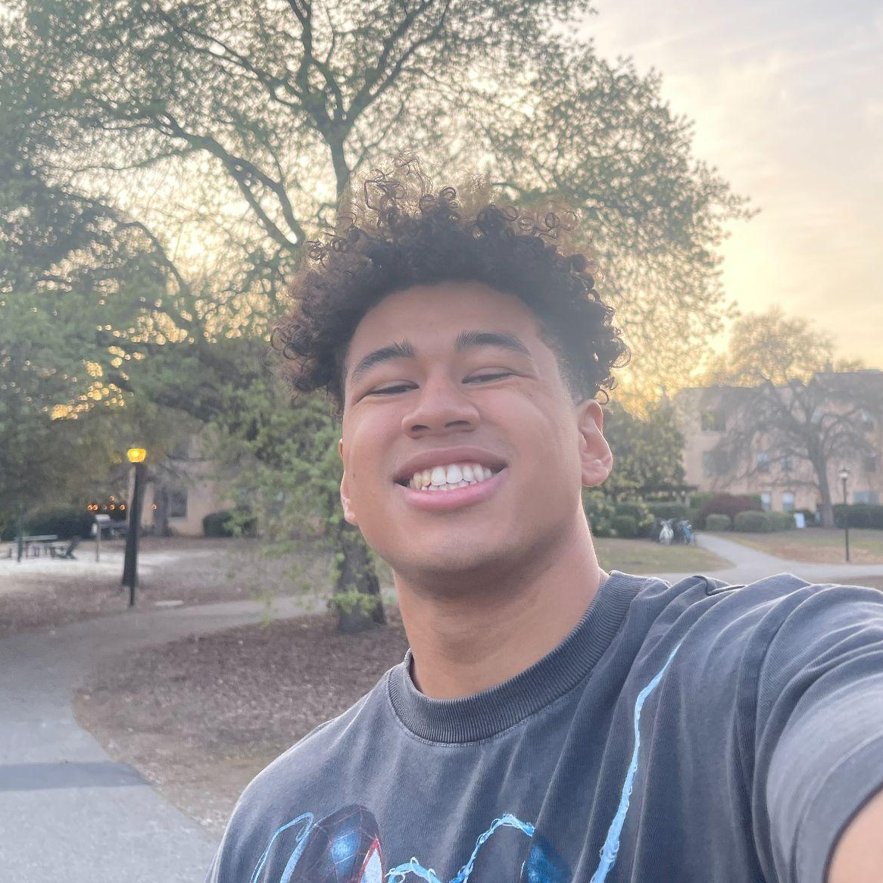
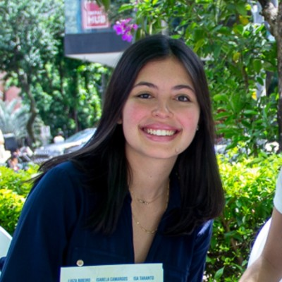
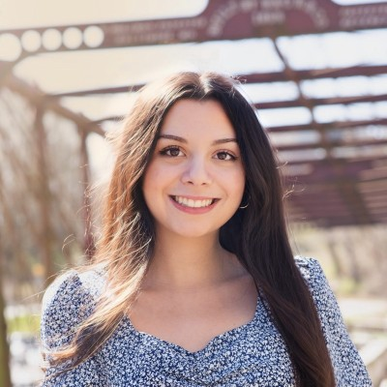
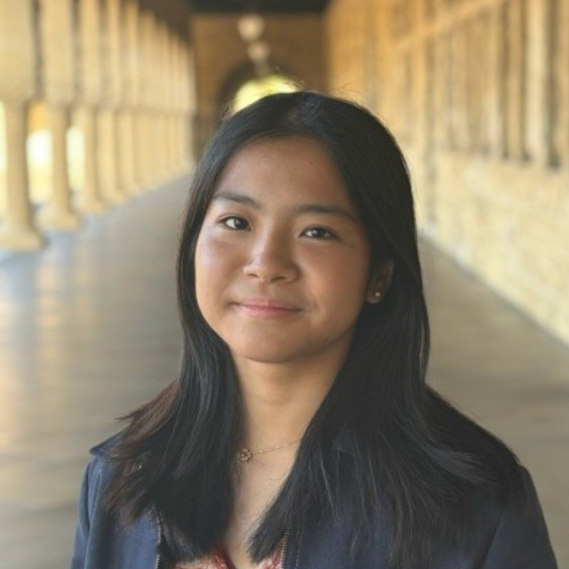
Team
Elijah
Luiza
Claire
Mikela
Symbolic Systems ‘26
Design + CS ‘28
Computer Science ‘27
Symbolic Systems ‘27

Slide 3
Recap
Last week we investigated the creative processes of artists.
We were interested in discovering how they plan their artwork.
Notes:
So as a quick recap of our project, last week we wanted to explore what the creative process was like for various different types of artists. We were ultimately interested in discovering how they plan and think about their artwork.

Slide 4
Narrowing our domain
How artists plan their creative projects
How artists organize their works & inspirations
Notes:
After conducting our interviews, we found a common thread: all of the artists mentioned having difficulties organizing all of their different artworks and sources of inspiration, which is why we narrowed our domain to focus on that in more depth.

Slide 5
Initial POV
We met Keith, a professional in digital art with over 25 years of experience in the industry.
We were surprised to realize
he looks for new ways to grow after seeing his friends try different things.
We wonder if this means
A friendly environment would probably help him make better art.
It would be game changing to
let him try out a few different creative options.

Slide 6


Additional Interviews
Fred - Fashion Designer/Founder
Interviewer: Luiza
Location: CoDa
Heather - Painter
Interviewer: Mikela & Elijah
Location: Zoom
Notes:
We conducted additional interviews with Fred, a fashion designer and founder from San Francisco. We decided to interview him because of his positive attitude toward technology and AI as a way to boost creativity and productivity. The second person we interviewed was Heather ….

Slide 7
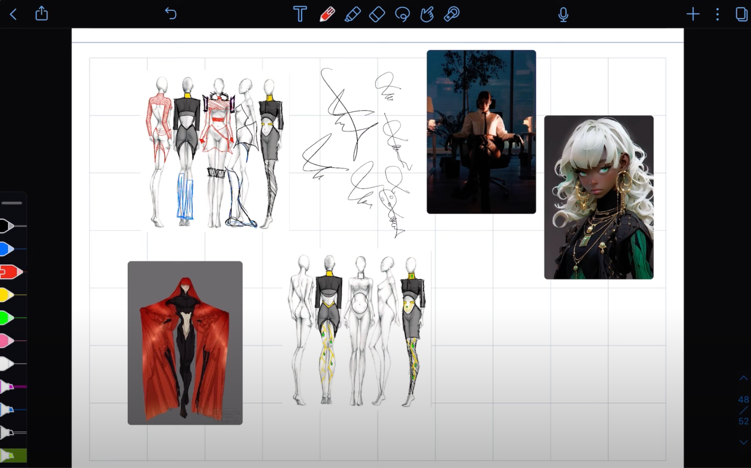
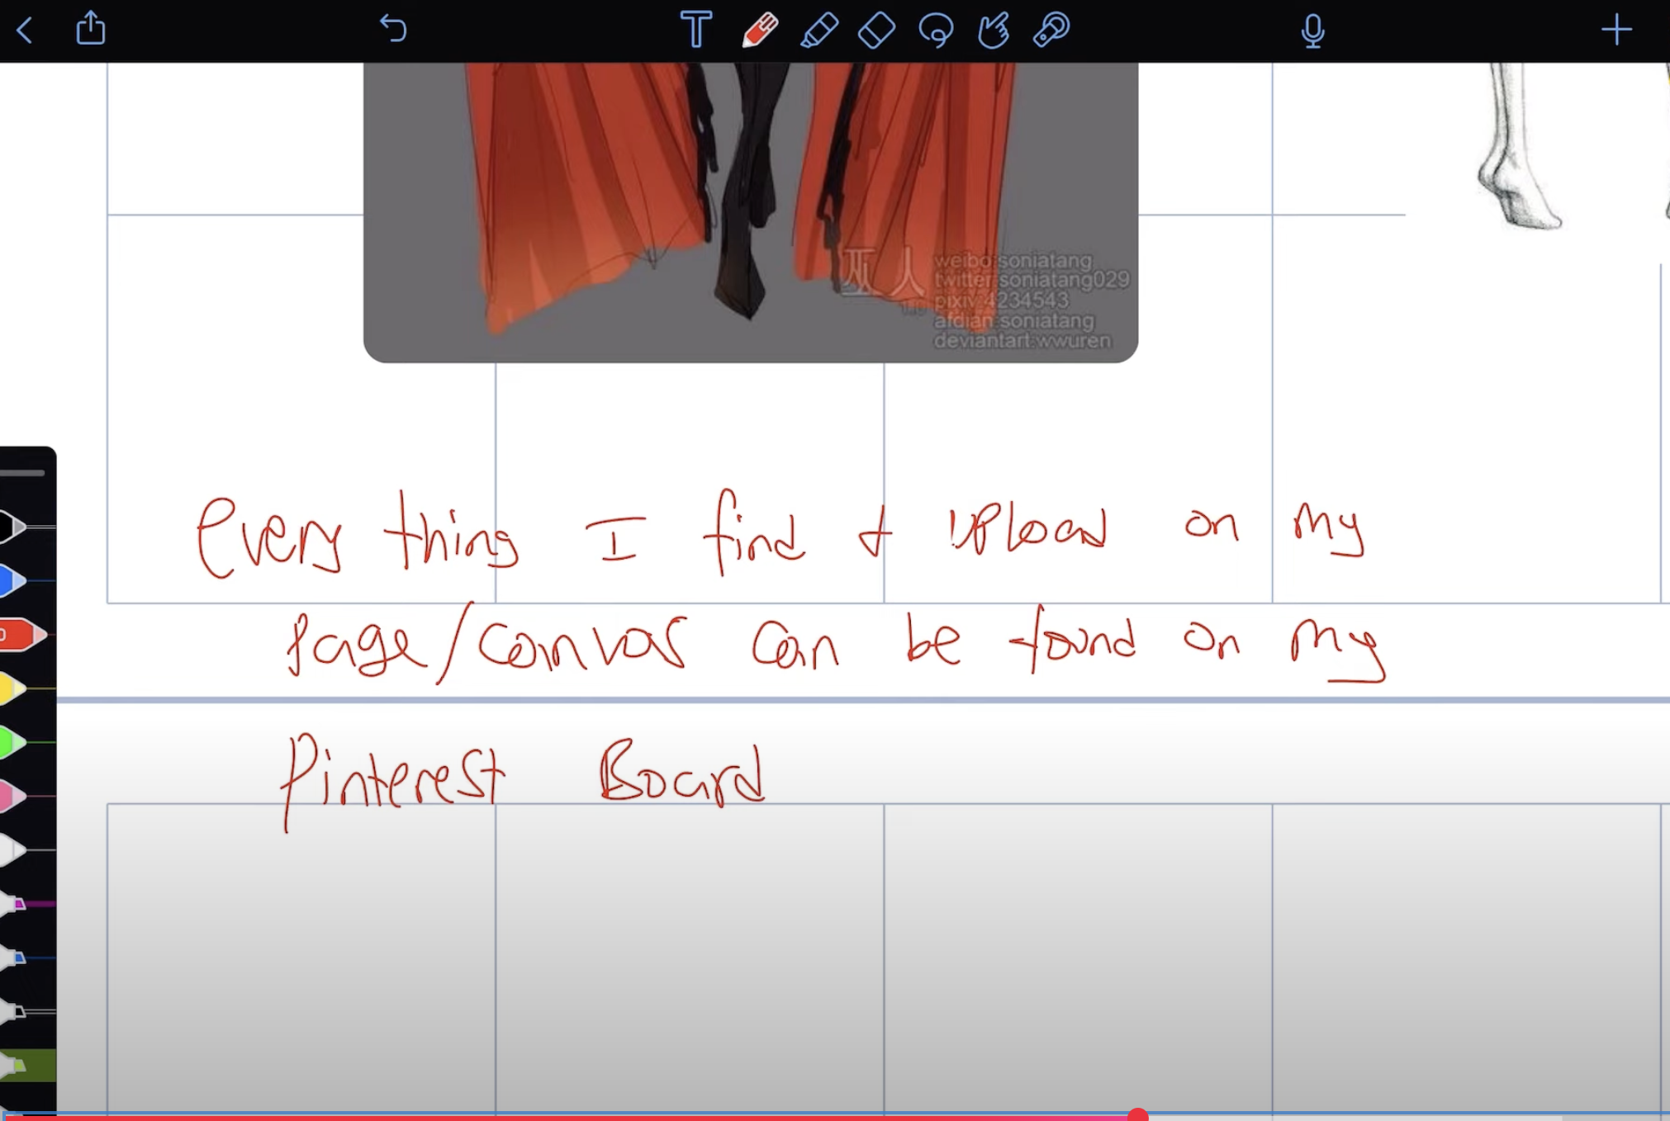
Findings
-Believes that AI can be a helpful tool in the design process.
- Finds that collaboration makes creativity easier
- Thinks failing pushes his creativity
- When he creates, inspiration naturally comes.
Artifact
- Organizes his sketches in a Notes app (Notability).
- Puts pictures of things that inspires his outfits next to the designs.
- Thinks it’s hard to capture inspiration.
- Gets inspired while walking and listening to music.
Fred
Notes:
The most important findings that we gathered from Fred’s interviews was that he finds inspirations everywhere around him, but he finds it hard to capture all of them. He does organize his pieces an ideas in a notes app called Notability, and puts images next to his designs to help inspire him, but he doesn’t spend that much time in the planning phase because he doesn’t have time to. He has to deliver his designs in 24 hours, so he focuses on making them, rather than planning them.

Slide 8
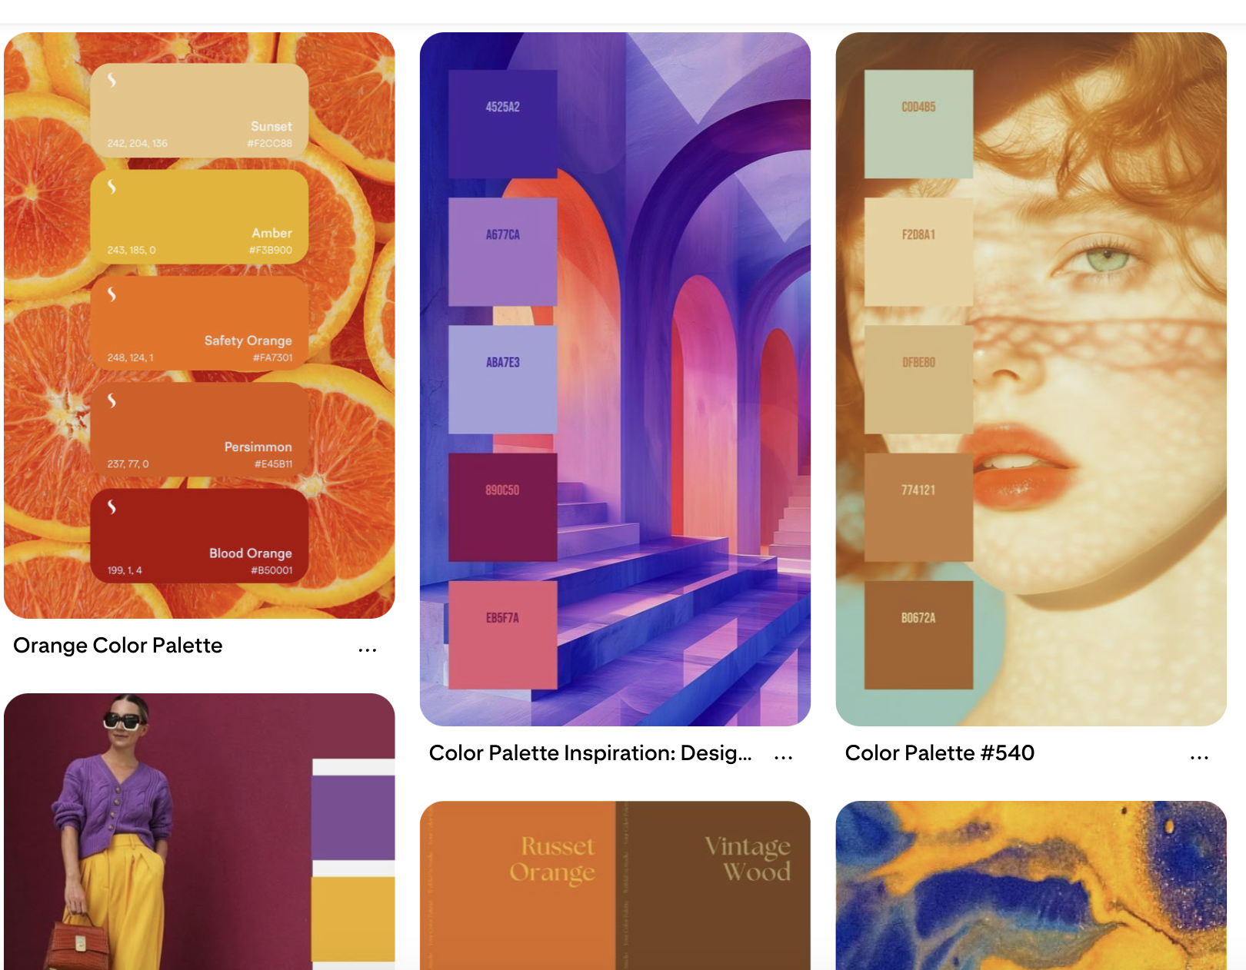
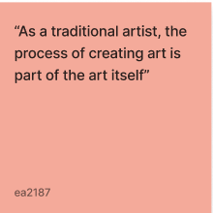
Findings
-She has difficulty being on technology for a long time due to a chronic condition
- She is very organized when it comes to commissioned art but disorganized when it comes to her own
- She wishes more apps incorporated voice notes into their interface
Artifact
- She really enjoys the art making process
- She doesn’t currently use AI in her artmaking process
- She uses tools like Pinterest and Milanote to create mood boards
- She doesn’t have one specific place to keep all of her inspiration
Heather

Slide 9
POVs and HMWs

Slide 10
POV #1 – Keith
We met Keith, a professional in digital art with over 25 years of experience in the industry.
We were surprised to realize
he finds new opportunities to direct his growth, as he is inspired by peers to explore new mediums.
We wonder if this means
An emotionally stimulating environment would help him produce more meaningful artwork.
It would be game changing to
provide multiple mediums where he can feel inspired.
Notes:
We did our first POV on Keith. Keith is a professional in digital art with over 25 years of experience. We were surprised to realize that he naturally finds new opportunities to direct his growth as he is inspired by peers to explore new mediums. He would jump around and feel motivated to try many different types of art because his friends would introduce him to different tools and art styles. We wonder if this means that a stimulating environment could help him produce more meaningful work. It would be game changing to provide various sources of mediums where he can feel inspired.

Slide 11
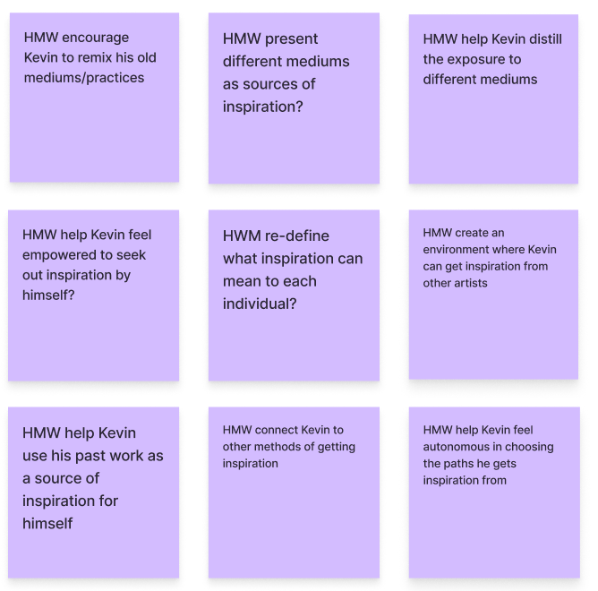
HMW encourage artists to share ideas and inspiration with others?
Notes:
So given that one of Keith’s primary sources of inspiration was from friends sharing different mediums/art tools they have experience with, we decided to investigate how might we encourage artists to share ideas and inspirations with others.

Slide 12
POV #2 – Willow
We met Willow,
a 20-year old film student at the University of North Carolina School of the Arts
We were surprised to realize
she had a system of noting down spontaneous sources of inspiration, but found it hard to decipher them later
We wonder if this means
She prioritizes accessibility and promptness over a structured, organized system
It would be game changing to
Find a way to organize her ideas with as little effort as possible
Notes:
Our second POV was on Willow – a 20-year old film student at the University of North Carolina School of arts. We were surprised that she had a system of noting down and recording spontaneous sources of inspiration that she would gather throughout the day, but she had a hard time deciphering them later on. We wonder if this means she prioritizes accessibility and speed over a more structured and organized system. It would, therefore, be game changing to find a way to organize her ideas with as little effort as possible.

Slide 13
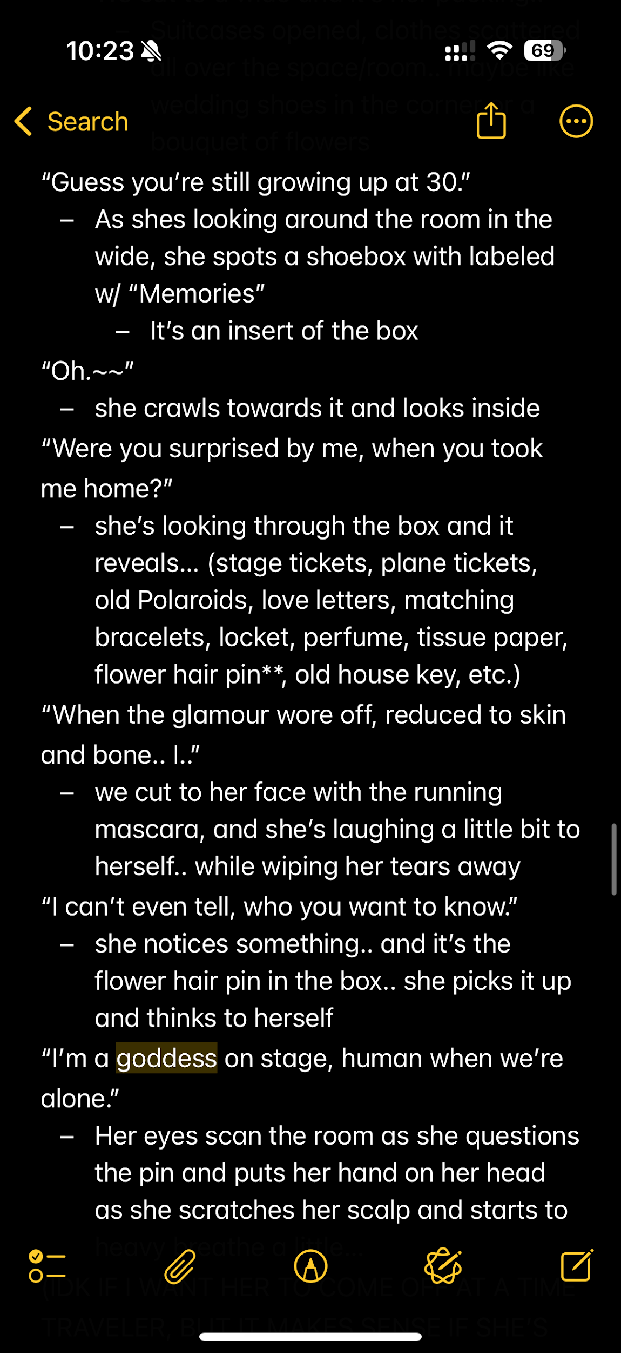
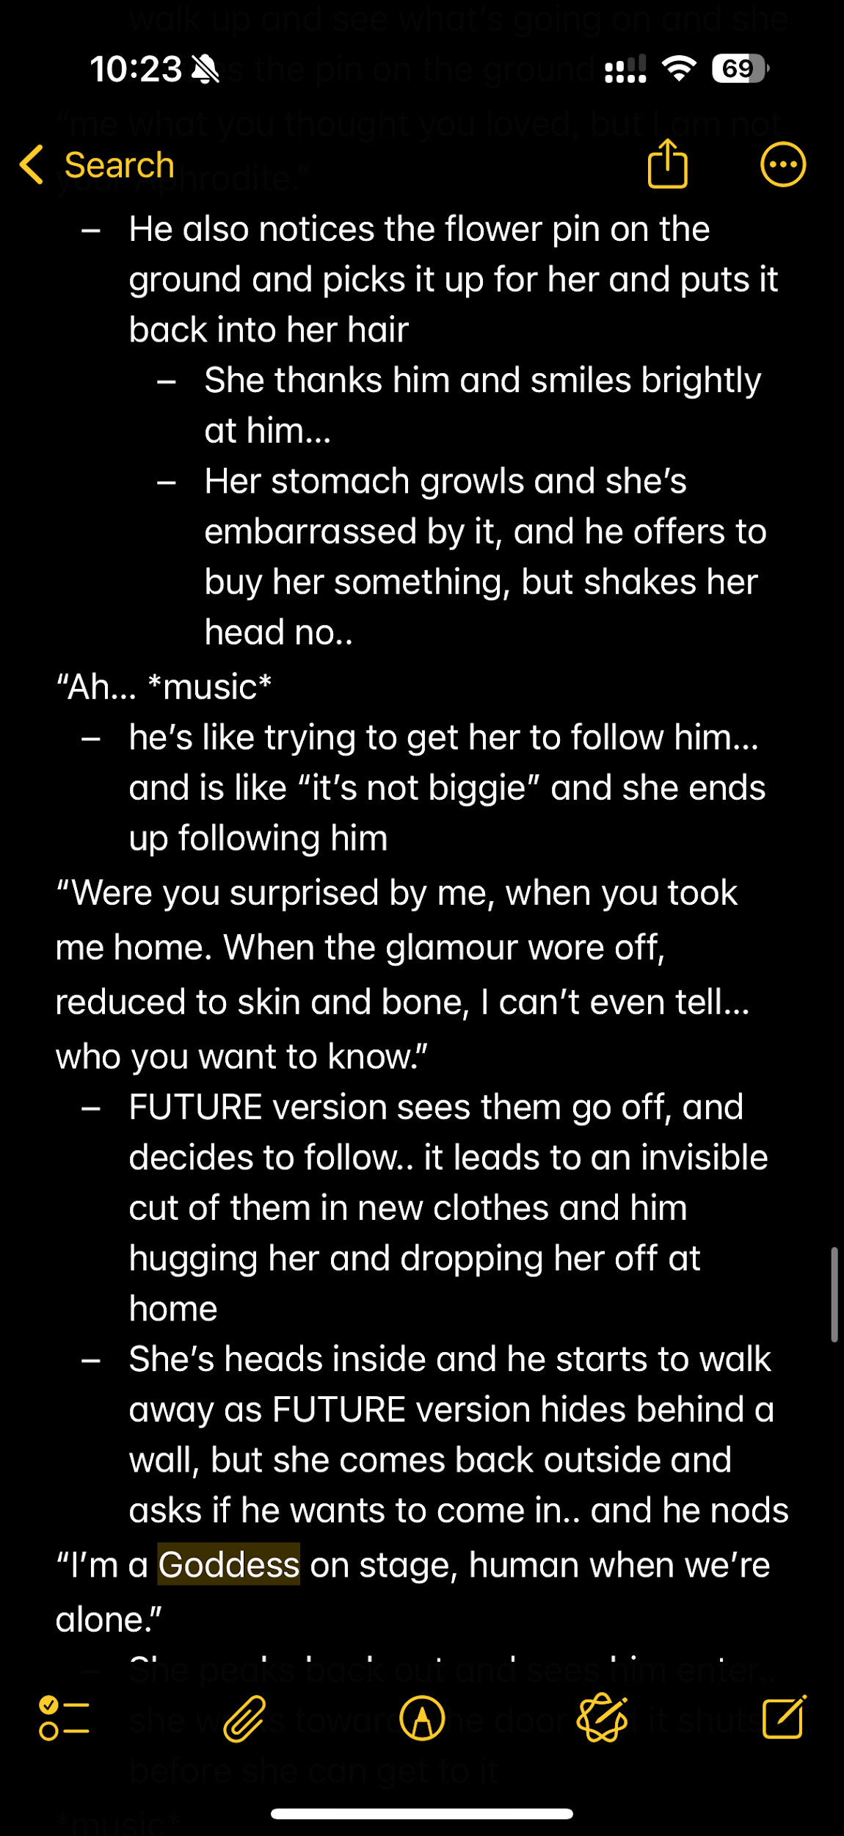
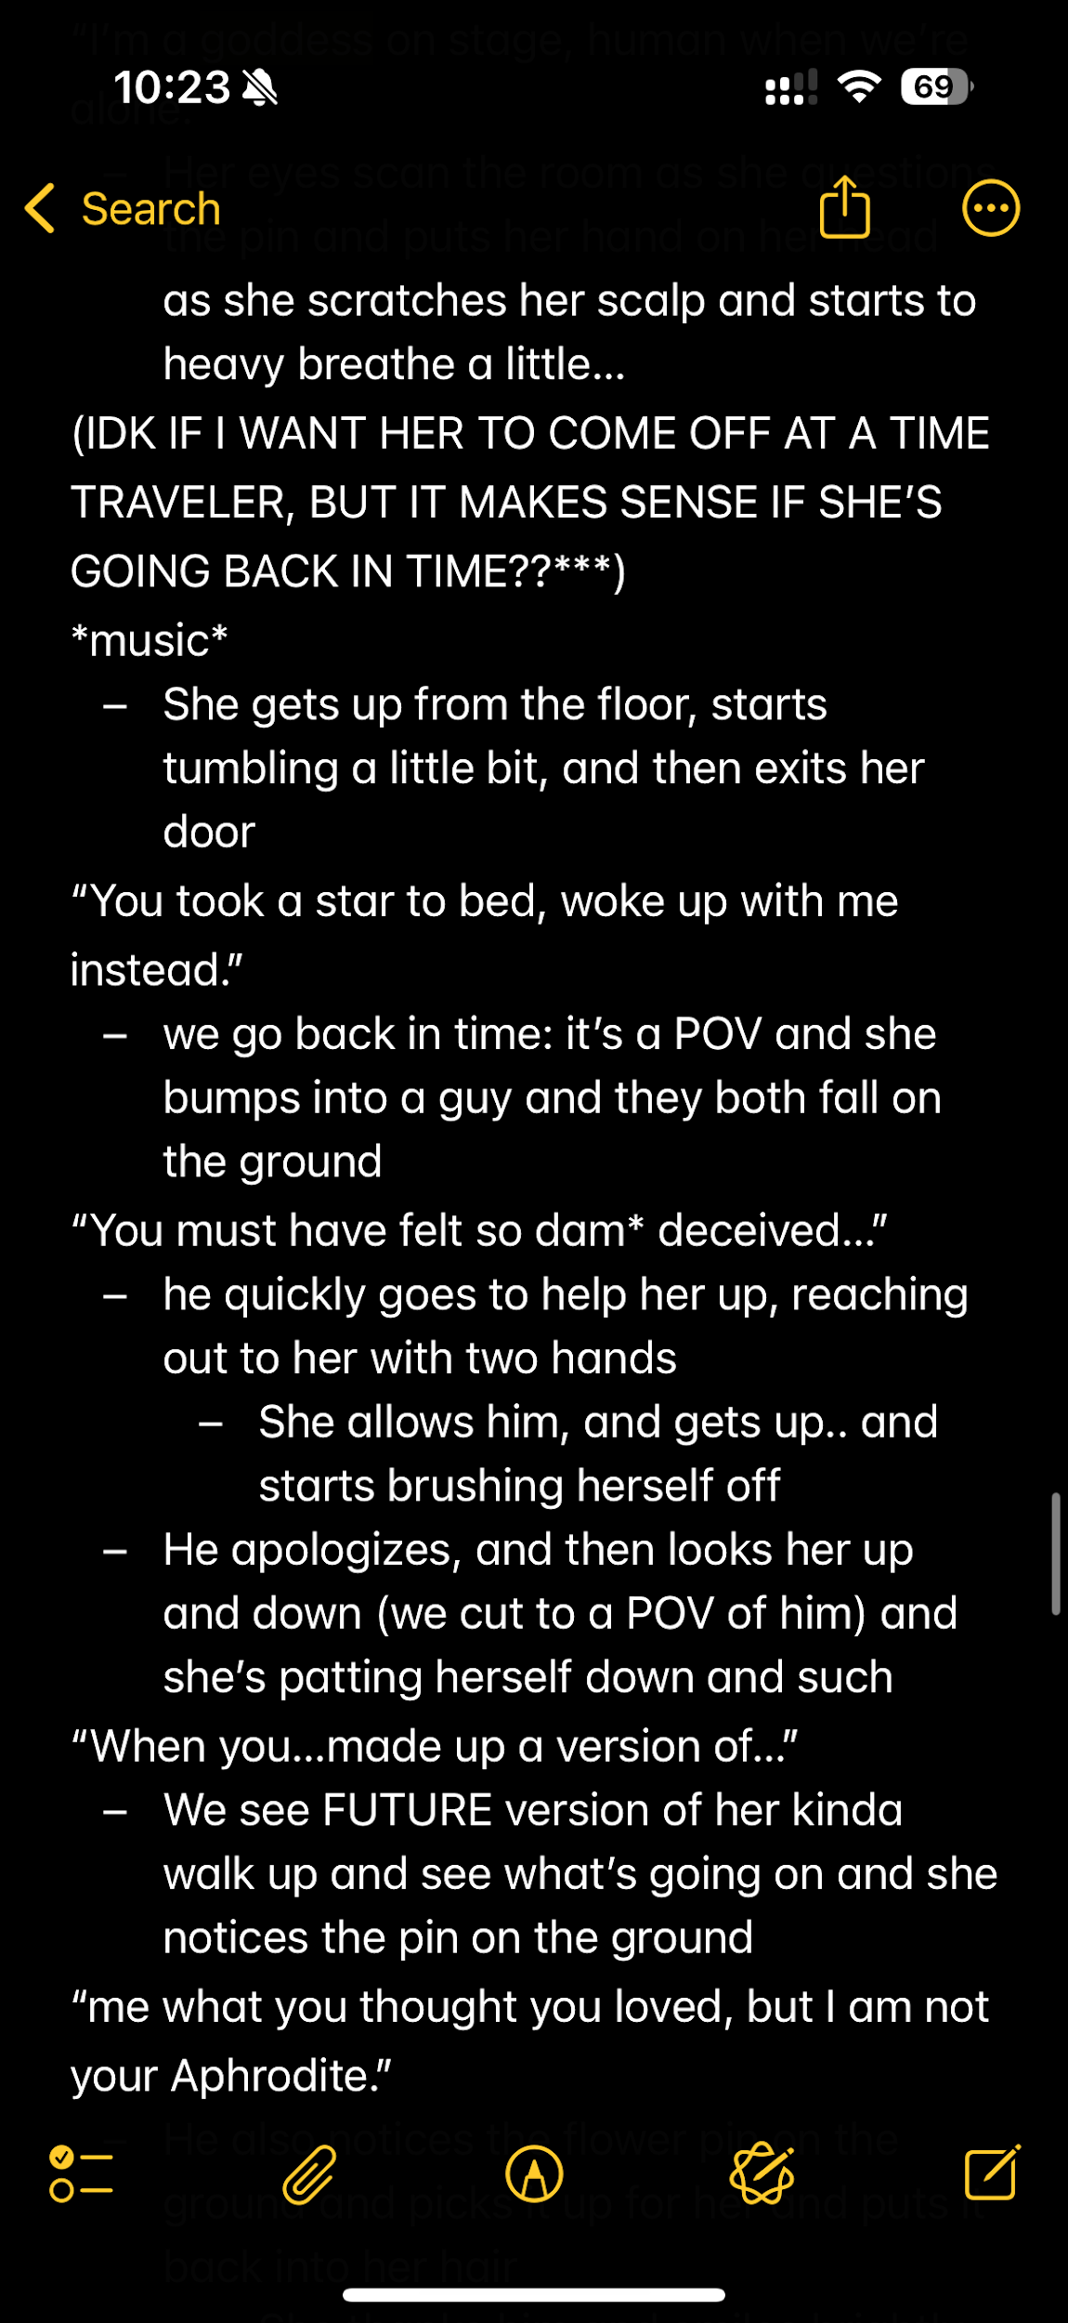
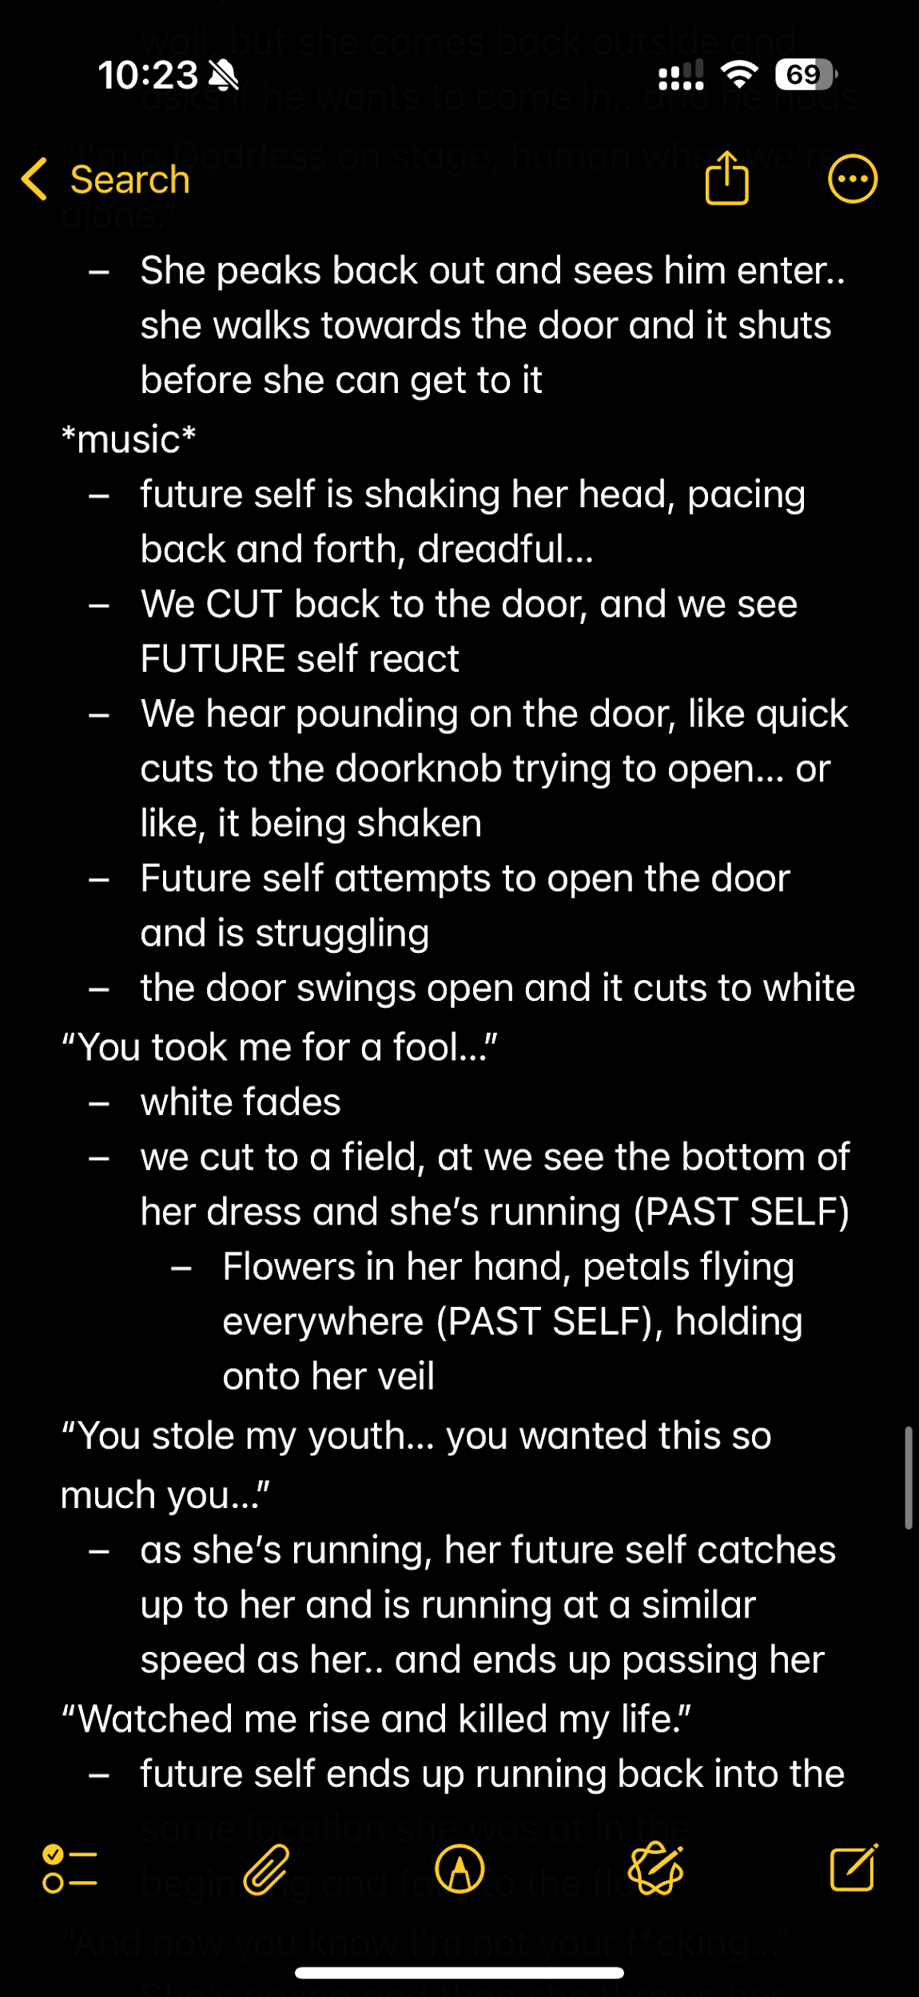
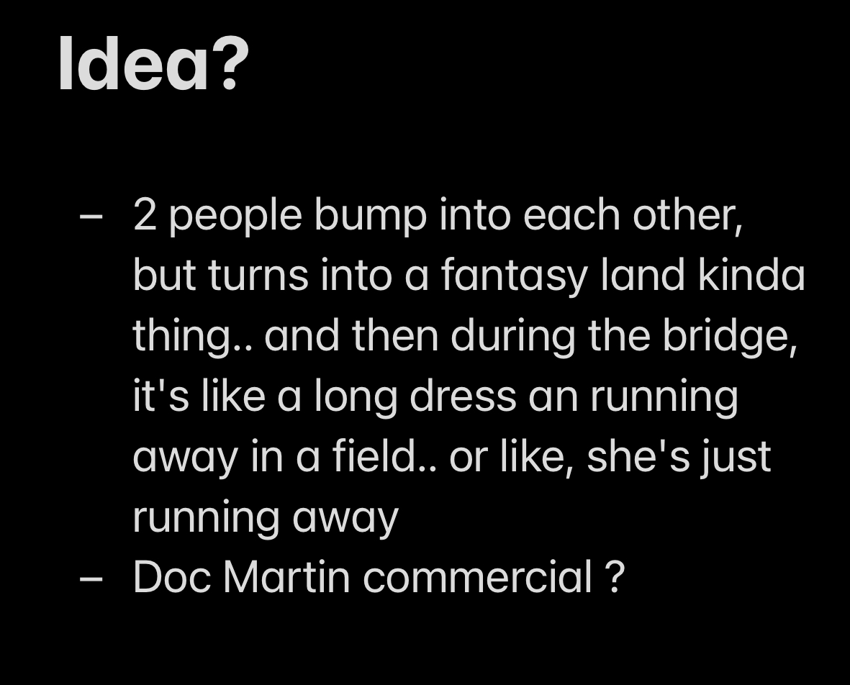
ex) Willow’s idea and script notes from recent film
Original idea: brain dump into notes
Entire script and shots stored in various notes
Notes:
Convenient – everything is all over the place

Slide 14
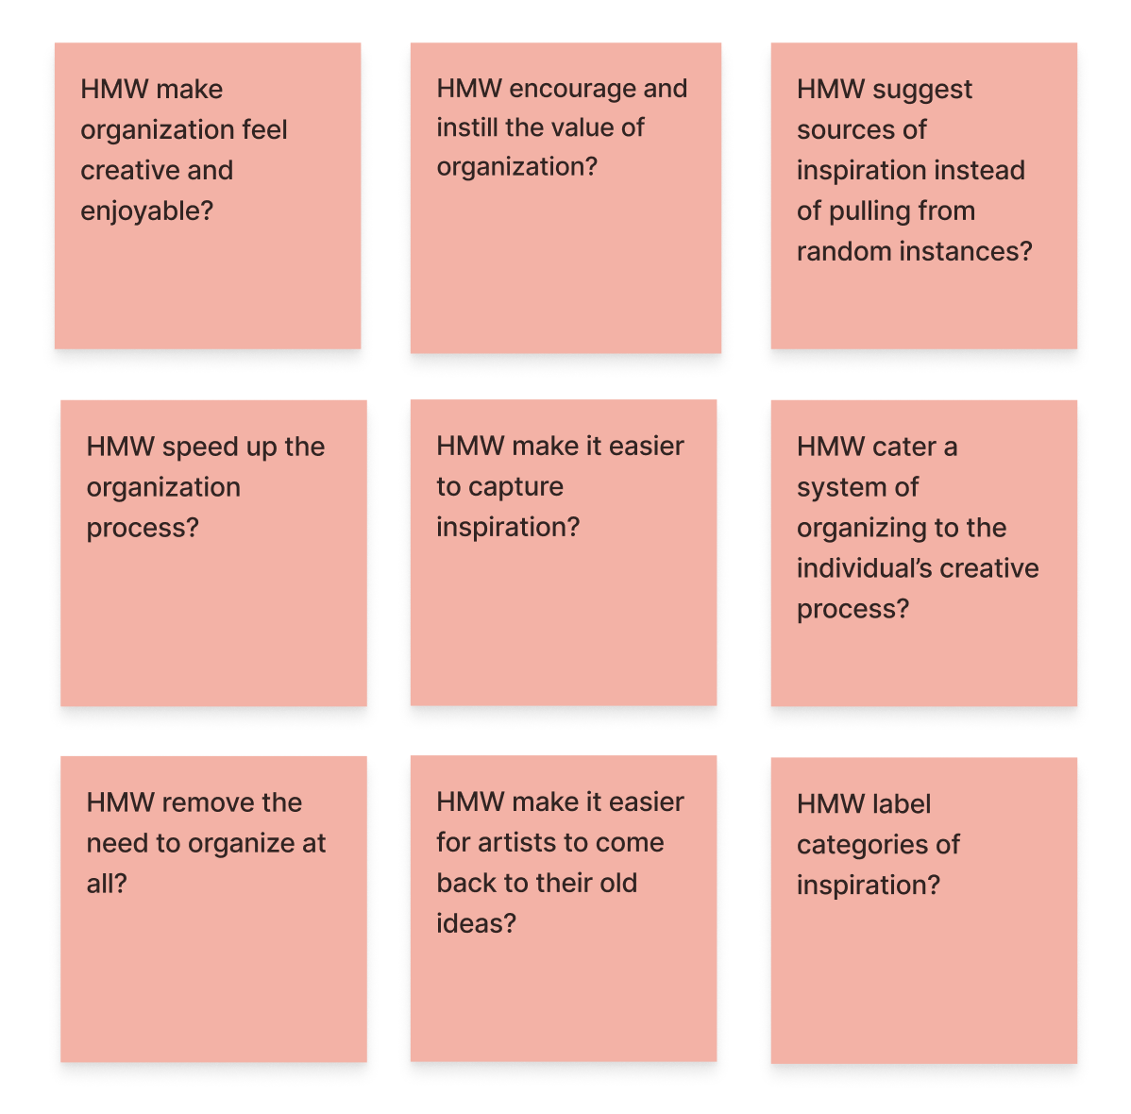
HMW support a system of organizing the artist’s unique sources of inspiration?
Notes:
Given Willow’s tendency to sporadically record various different sources of inspiration, we wanted to explore how might we support a system of organizing the artist’s unique sources of inspiration.

Slide 15
POV #3 – Fred
We met Fred,
a fashion house founder and designer.
We were surprised to realize
he avoids spending extensive amounts of time planning even in personal projects.
We wonder if this means
he enjoys the trial-and-error aspect of creating art.
It would be game changing to
facilitate the process of creating new things while maintaining an organized system.
Notes:
Our final POV was on Fred, a fashion house founder and designer. We were surprised to realize that he does not spend that much time planning his projects regardless of whether they are for his professional work. We wonder if this means that he enjoys the trial-and-error aspect of making art. It would be game changing to facilitate the process of creating new things while still being able to maintain an organized system.

Slide 16
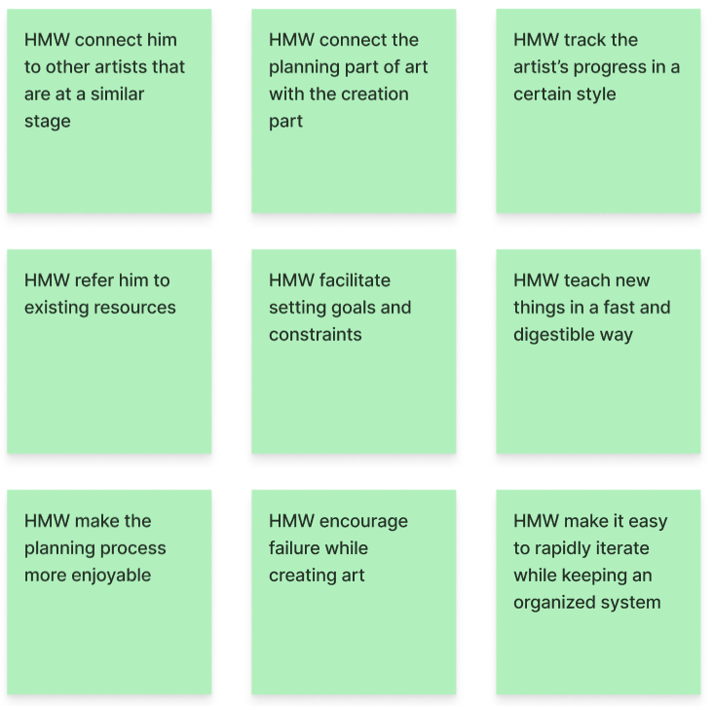
HMW make it easier for artists to come back to their old works that they have made over time?
Notes:
So given that Fred prioritizes fast iteration over planning, we wanted to find how we can better document this trial and error process in art, and more specifically, how might we make it easier for artists to come back to these old works/iterations they have made over time.

Slide 17
Solutions

Slide 18
#1: HMW encourage artists to share ideas and inspiration with others?
Solution
A place where artists can share things that inspire them (movies, playlists, etc.) for other artists to use.
Assumption
Creating art in a space with others takes the pressure off of artists and allows them to more freely create
Notes:
From our first HMW, encouraging artists to share ideas and inspirations with others, our solution was to create a place where artists can share things that inspire them, such as movies, songs, etc., for other artists to use. We are assuming that creating art in a space with others removes the pressure off of artists and allows to feel more free while creating.

Slide 19
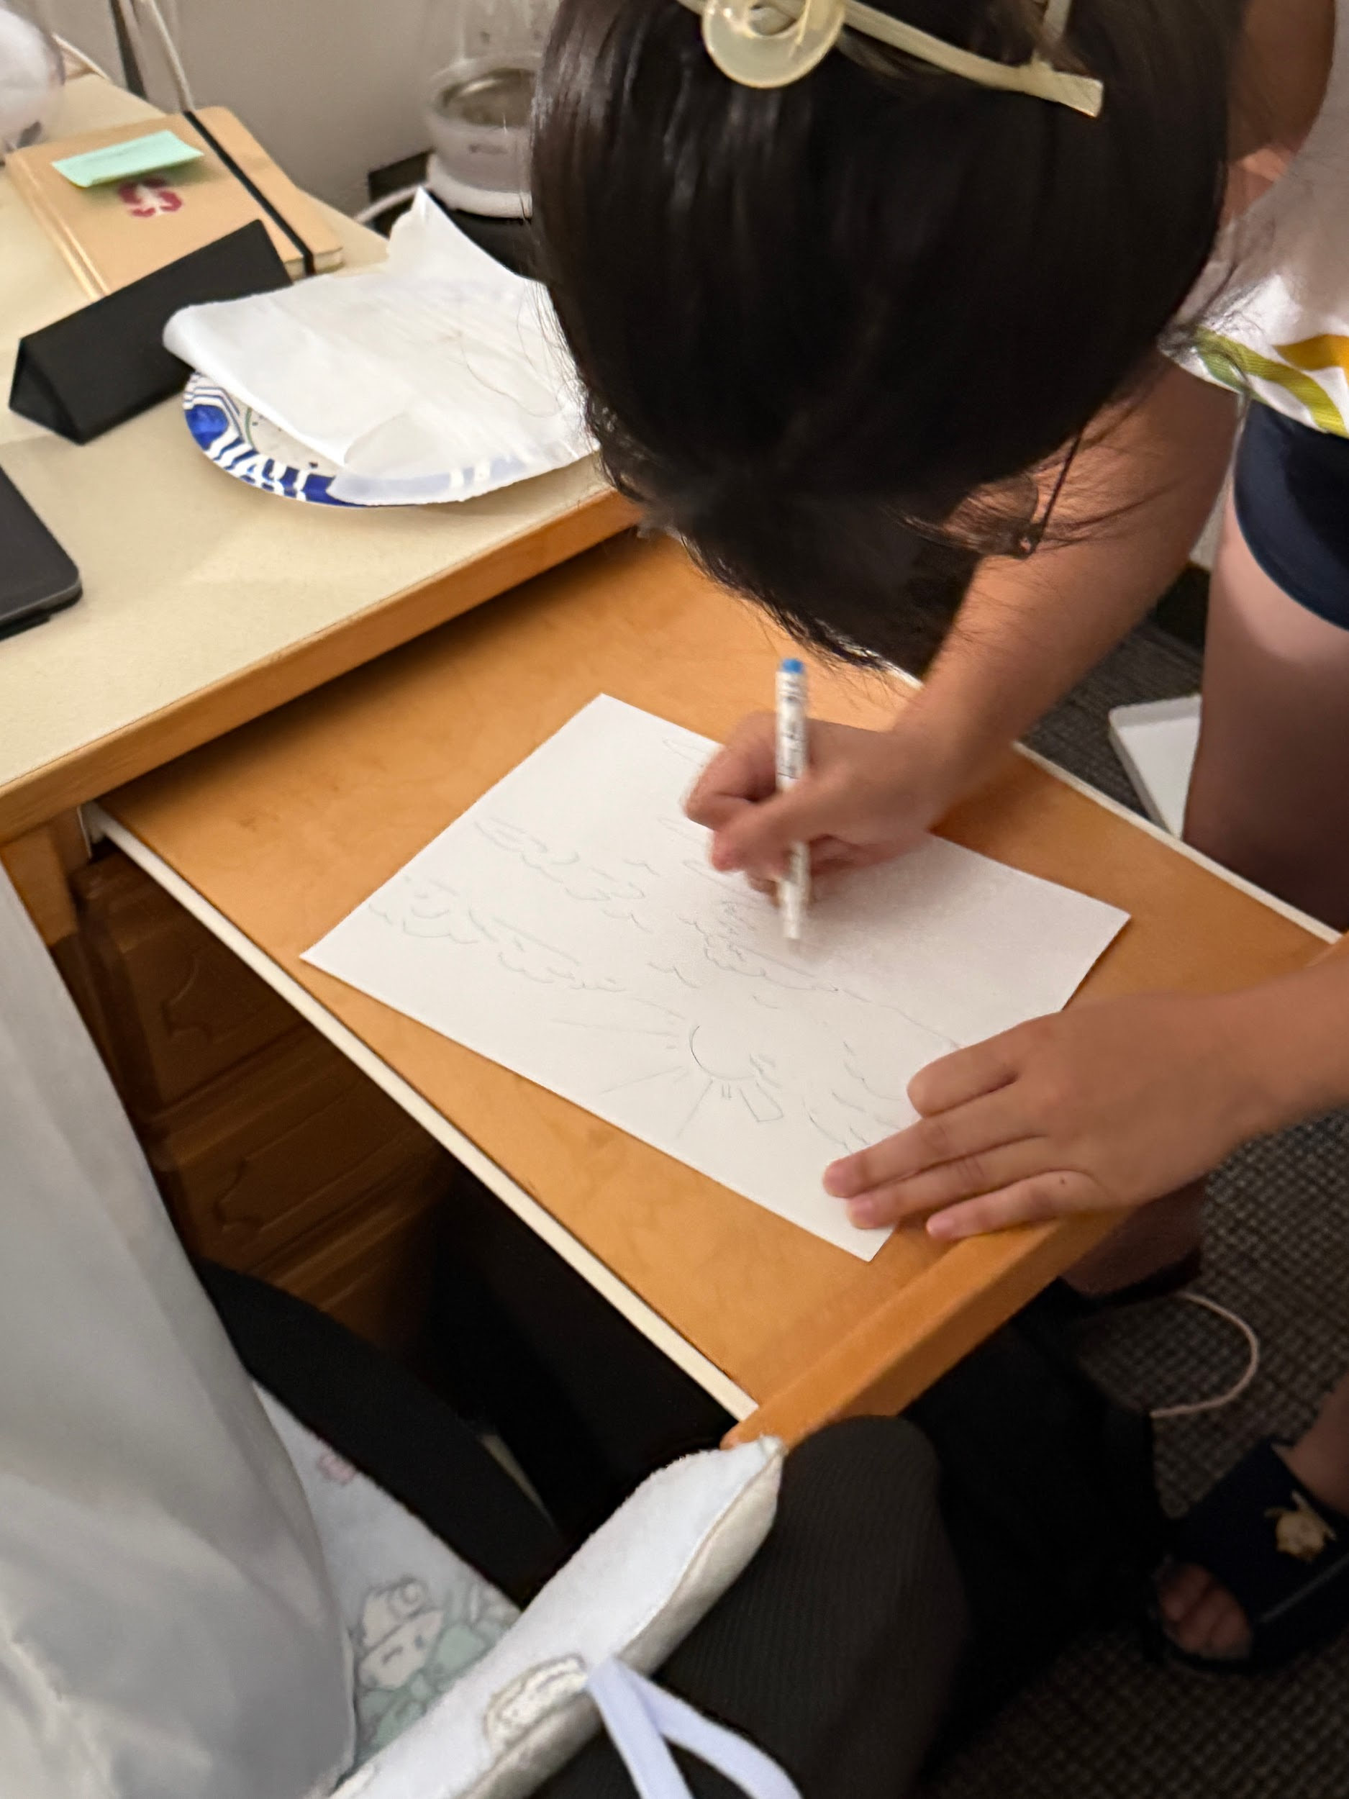
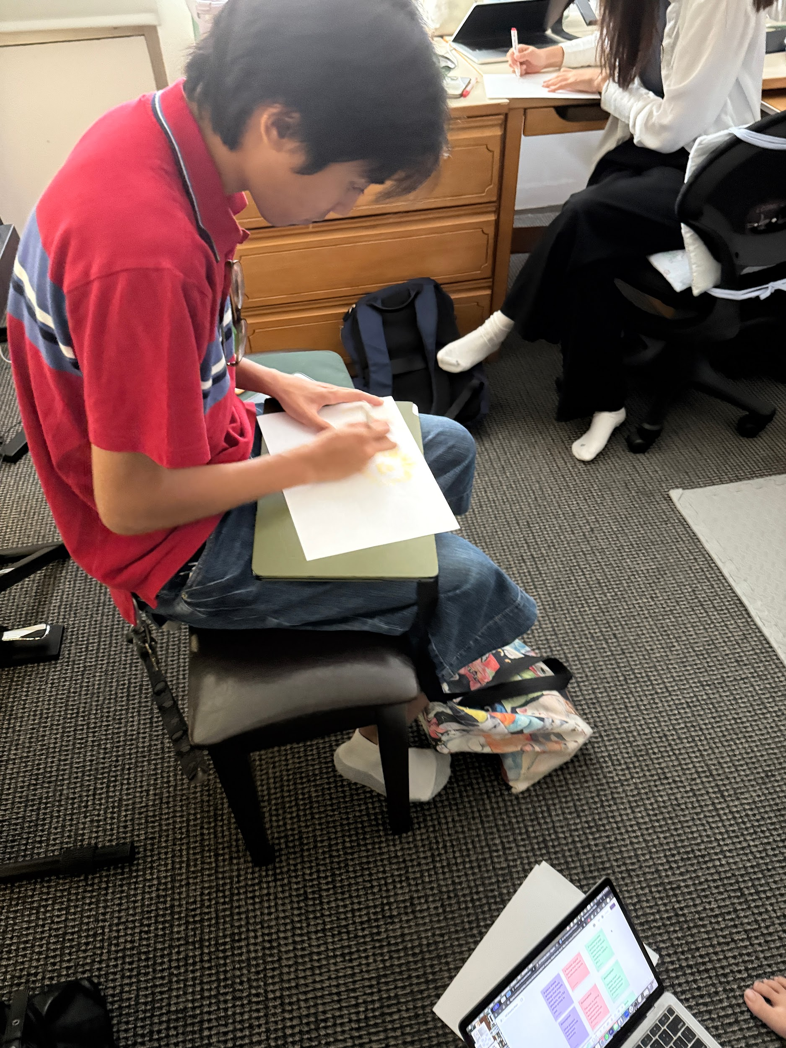
Experience Prototype #1
Who?
Students in dorm
Some artists, some not
What?
1 minute drawing
3 minutes discussing “music that inspires” them
1 minute drawing, playing one of those songs
Debrief activity after

Slide 20
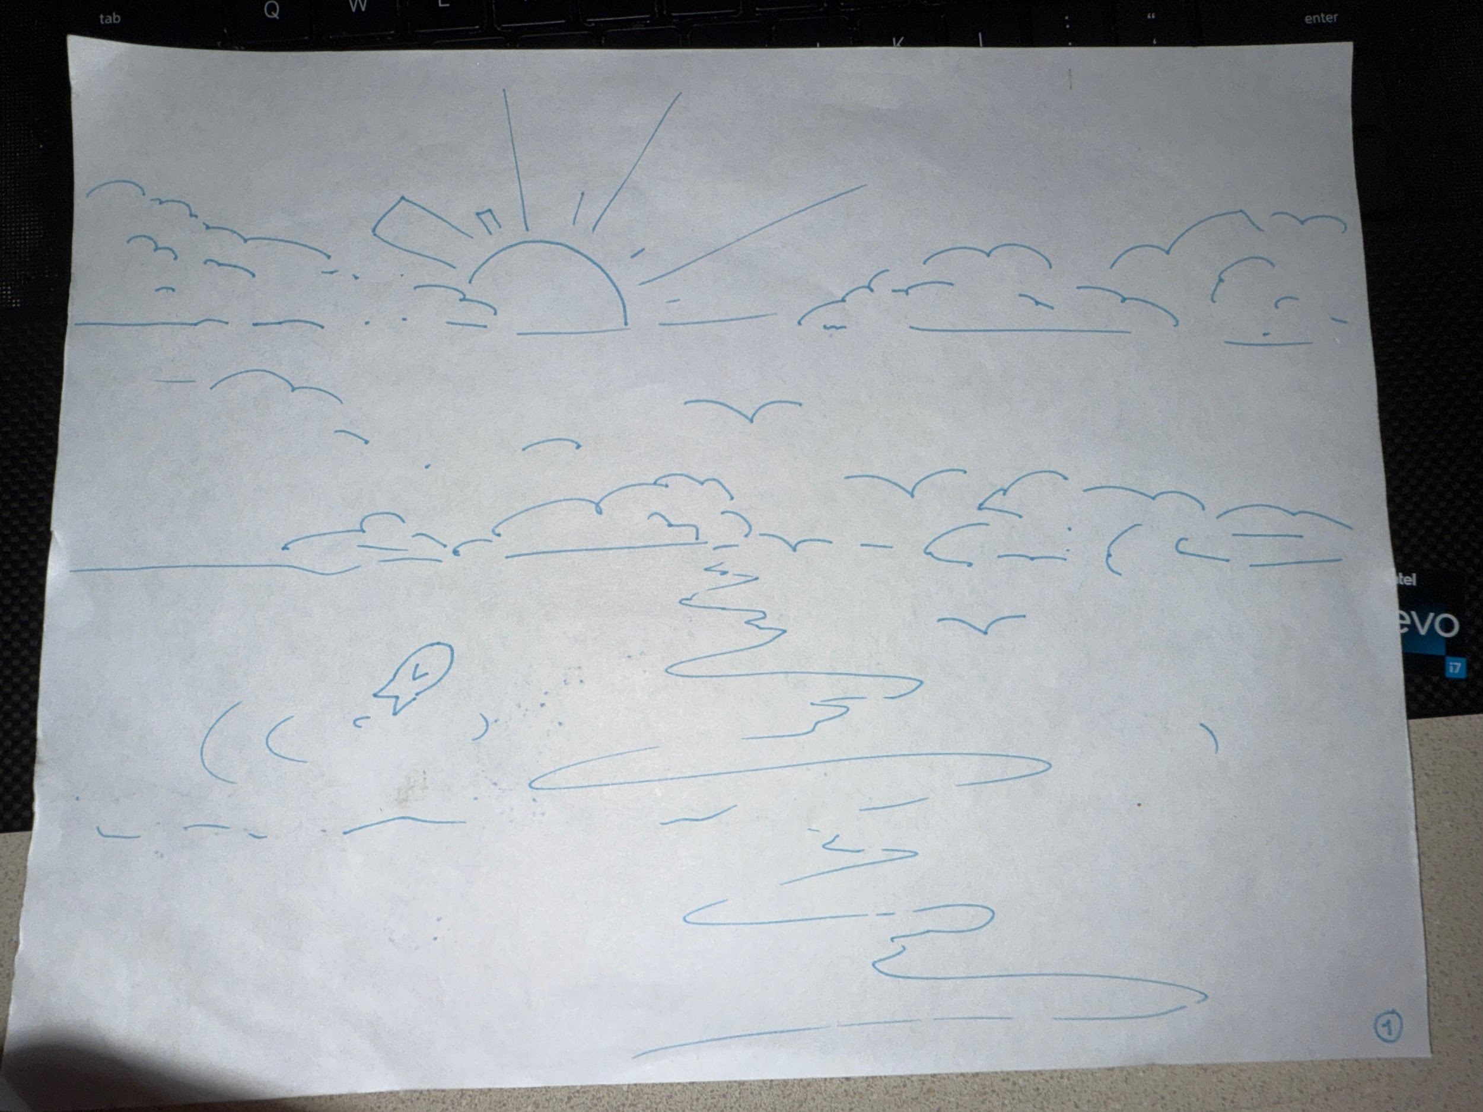
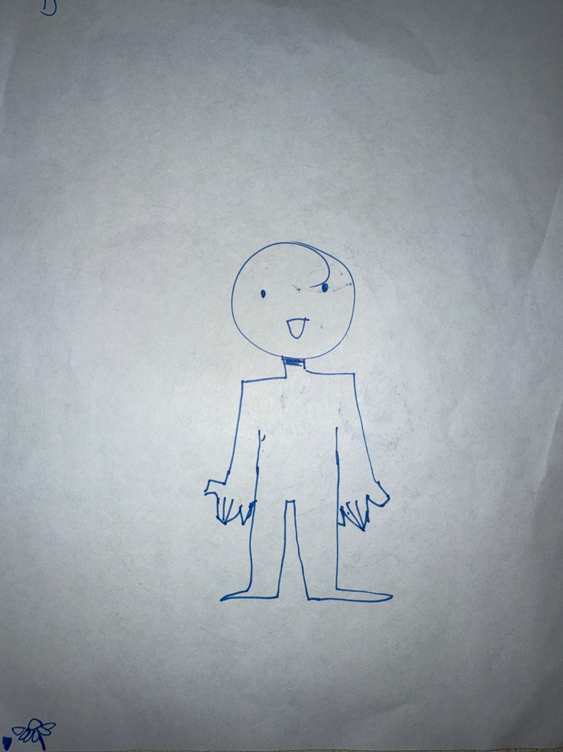
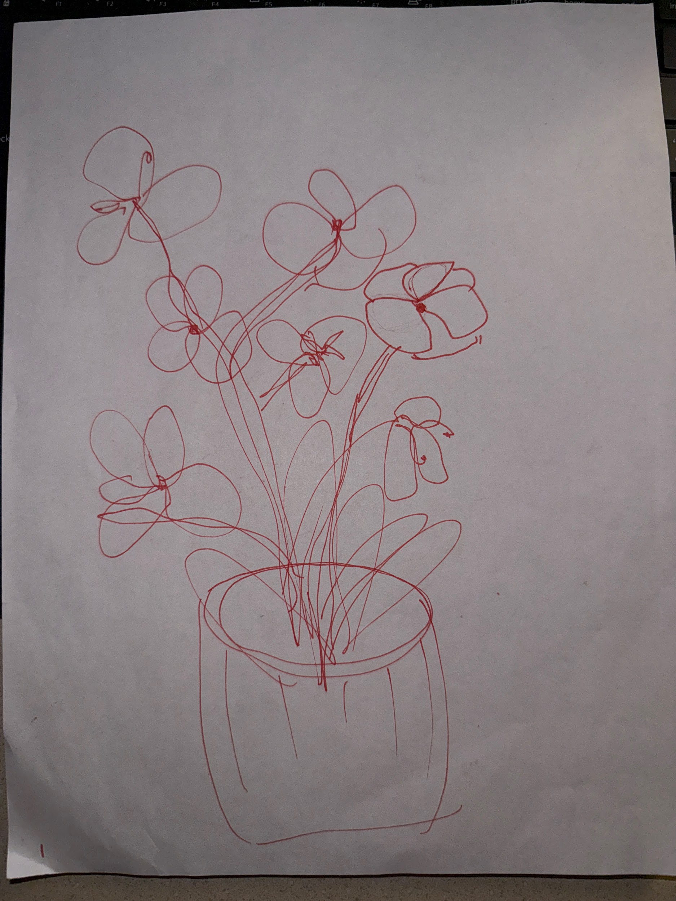
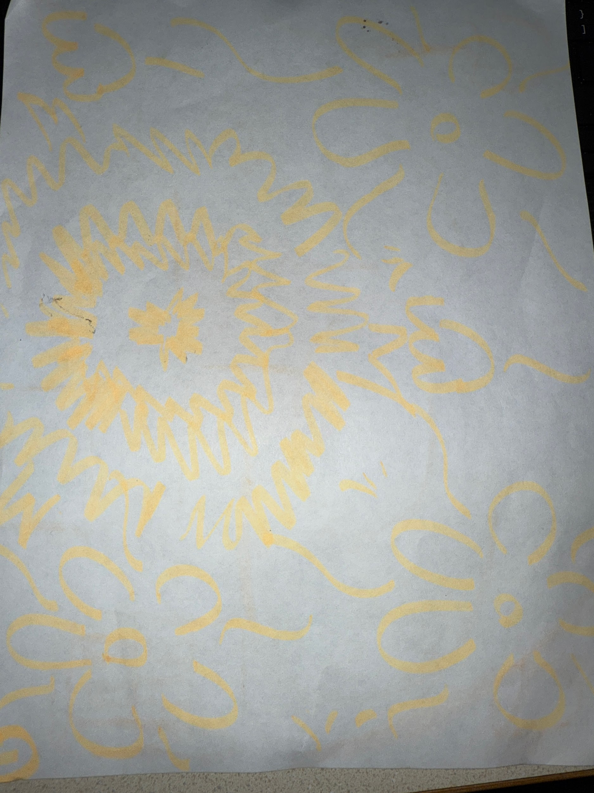
Drawing Round 1:
“clouds”
“Flowers I was drawing earlier”
“person?”
“Lego flowers in the room”

Slide 21
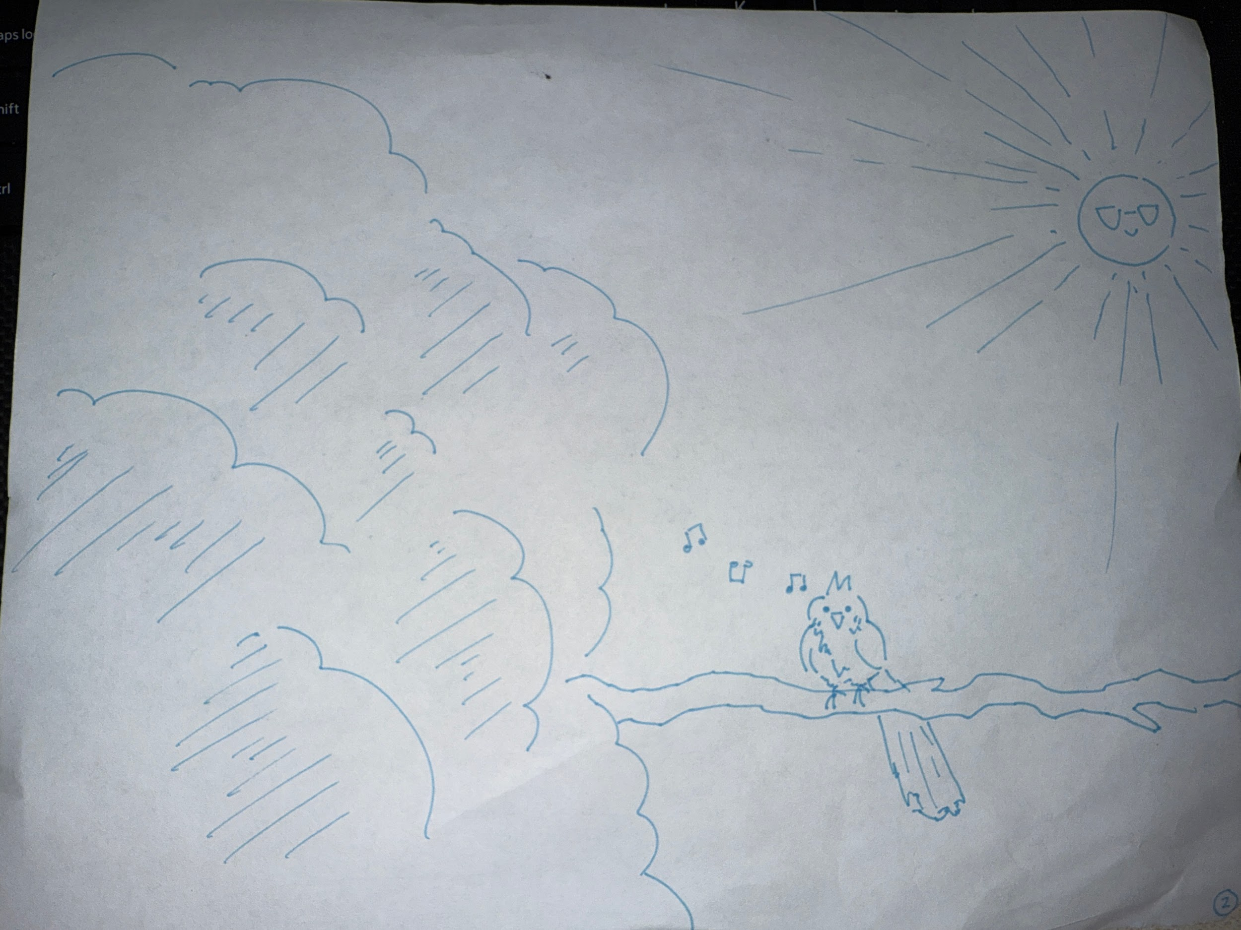
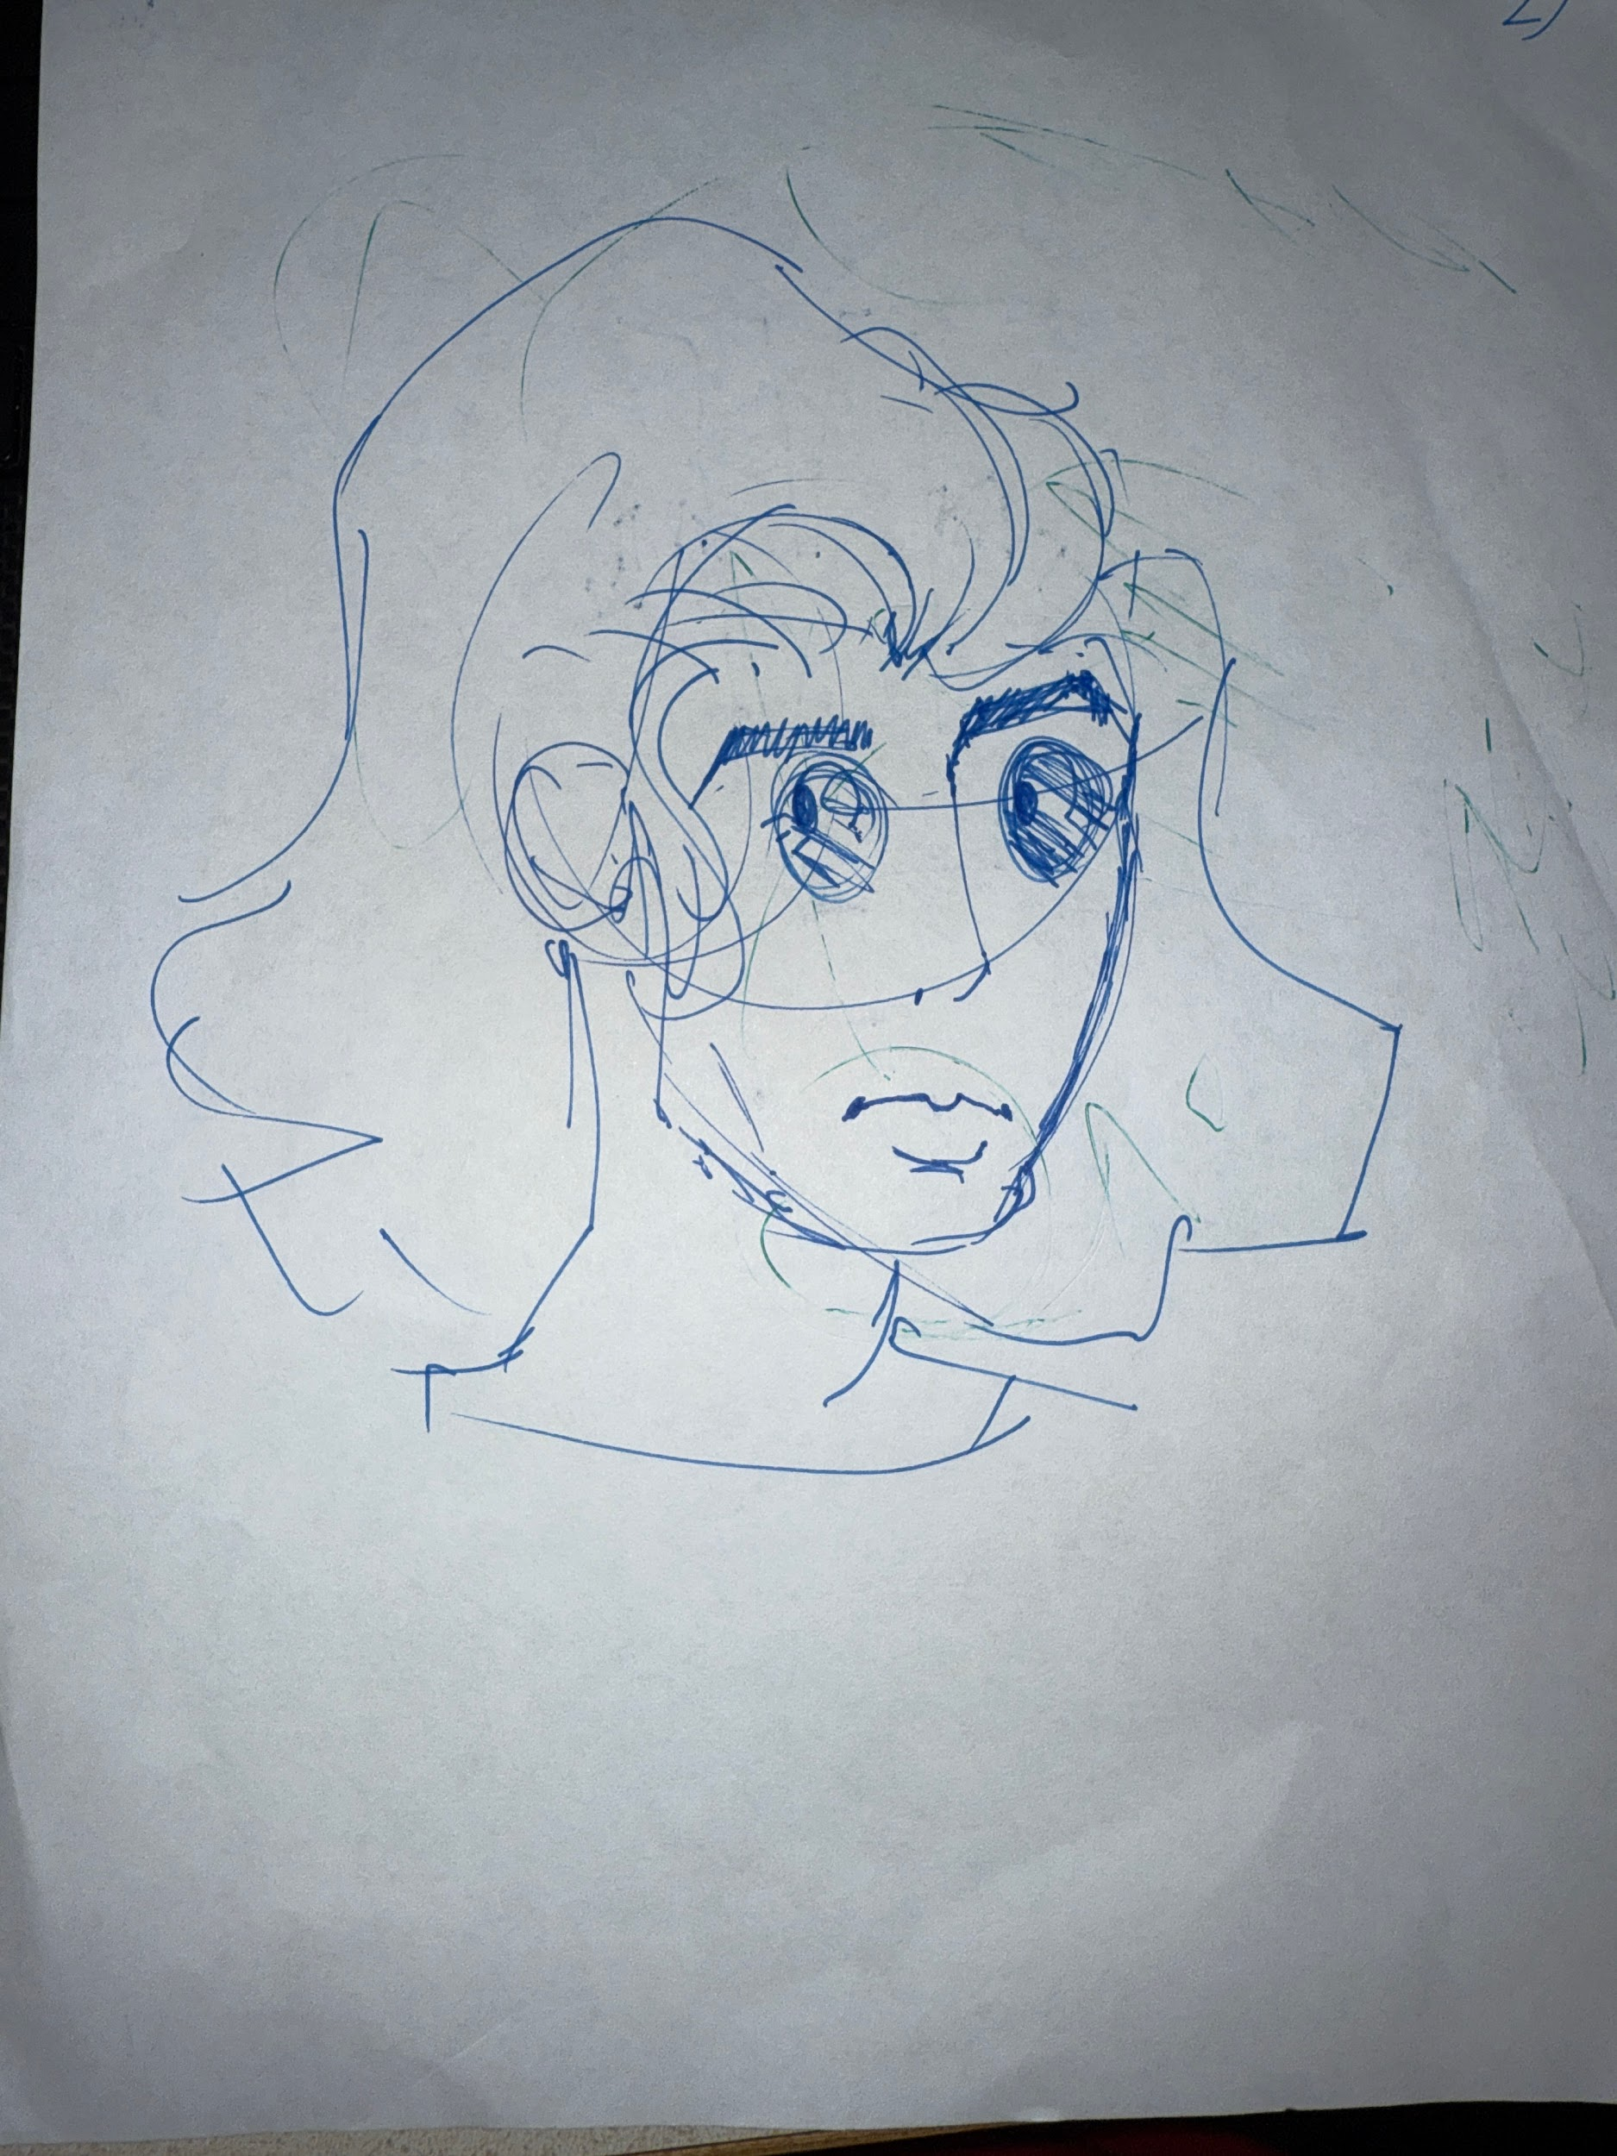
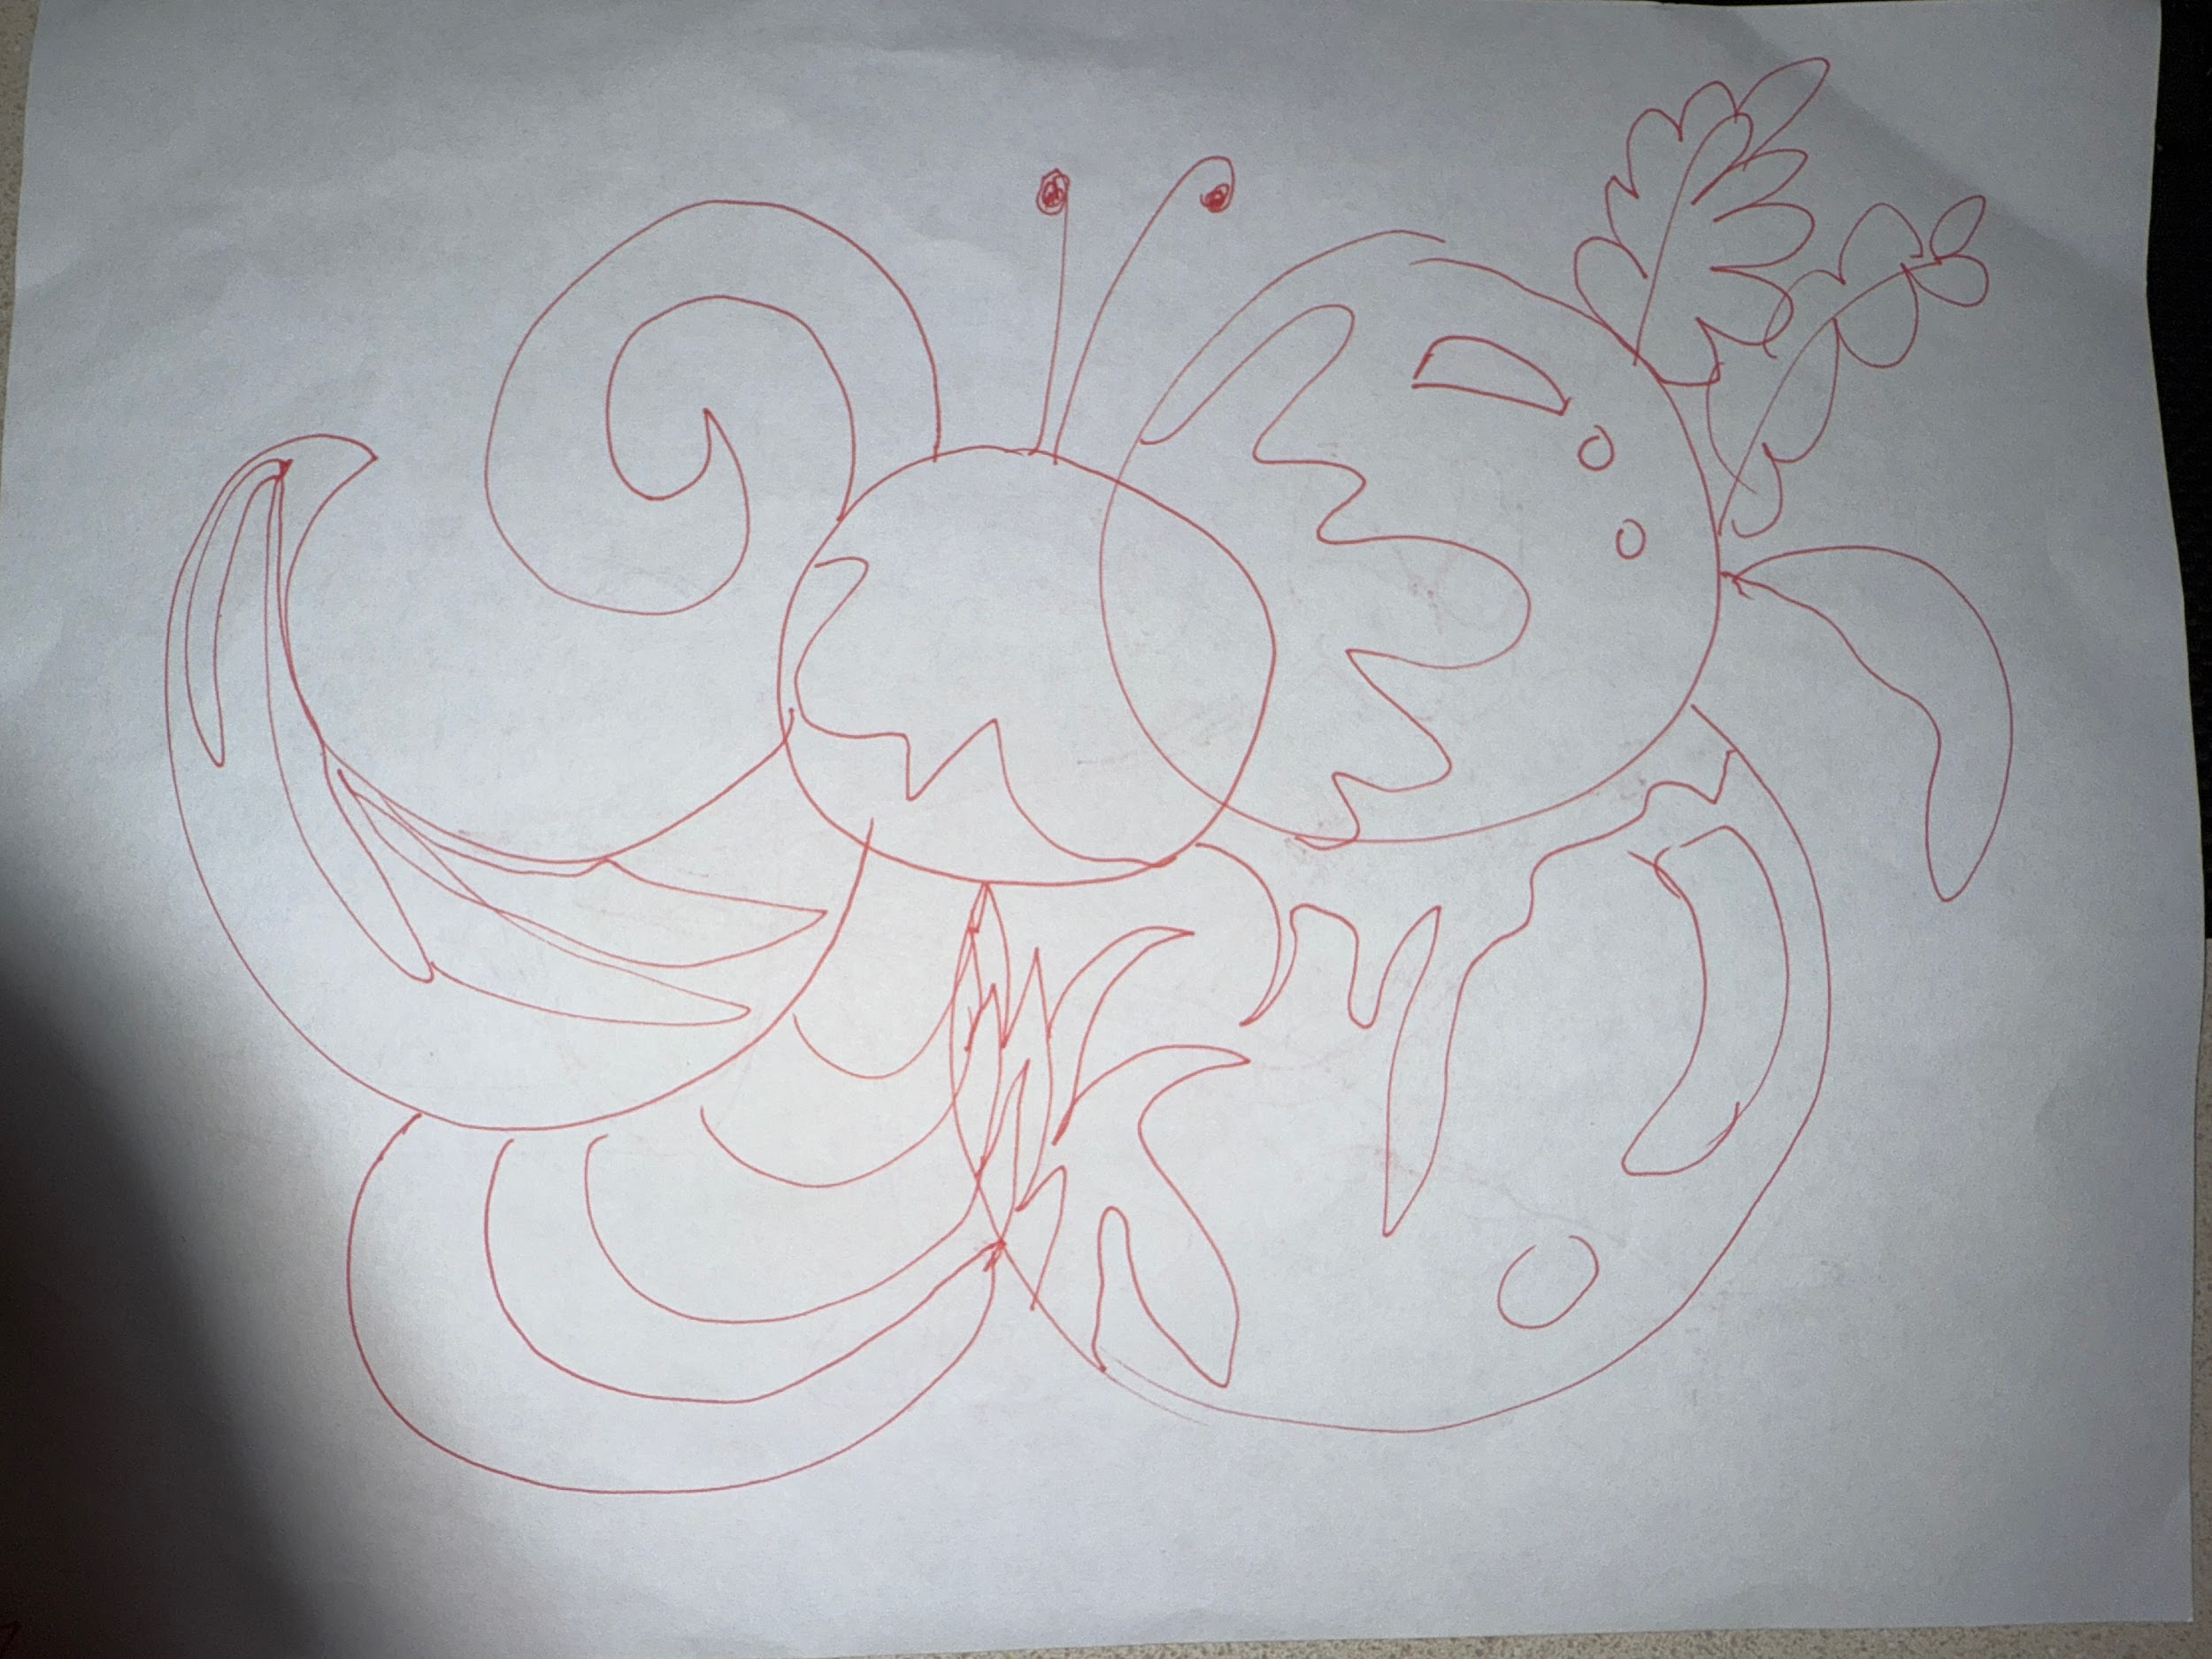
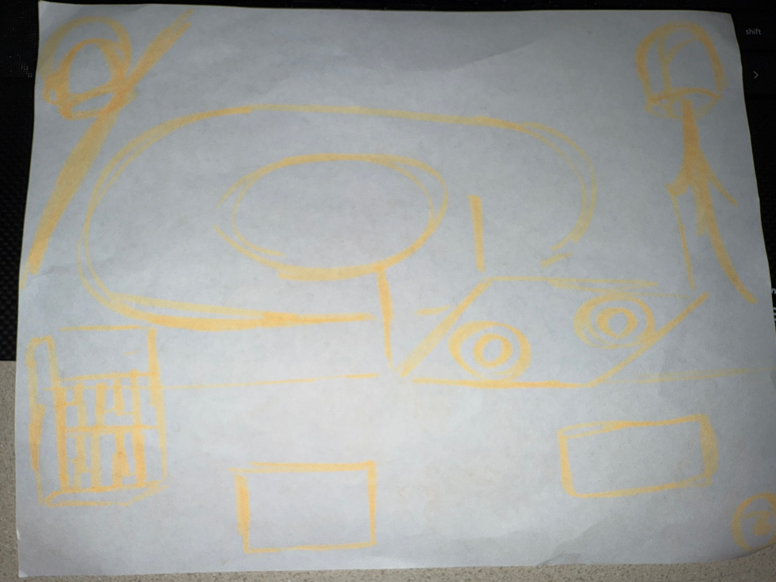
Drawing Round 2:
“songbird on a tree” + music notes
“cafe I was inspired by during conversation”
“Album cover I was reminded of”
“Random shapes and squiggles”

Slide 22
Results #1
What worked?
What didn’t?
Assumption
Participants found that the discussion and the music increased their creativity as it set a mood and allowed them to think about how different forms of art can be represented in various mediums.
All of them had different music that they preferred to listen to when creating, thus some of the participants had to compromise and use others’ preferred methods instead.
Proven (kind of). Though all artists preferred the mood of the second session with music and after discussion, there was tension regarding the most appropriate music.
Notes:
Worked: Talking about art/inspiration inspired them to be more creative. What didn’t: conflict about what actually inspires them,
Assumption: it did encourage them

Slide 23
#2: HMW support a system of organizing the artist’s unique sources of inspiration?
Solution
A flexible digital journal that takes multimedia inputs
Assumption
The user is willing to spend time documenting various sources of inspiration
Notes:
From our second HMW, supporting a system of organizing the artist’s unique sources of inspiration, our solution was to create a flexible digital journal that takes multimedia inputs. We are assuming that the user will spend x amount of time documenting these sources of inspiration.

Slide 24
Experience Prototype #1
Who?
College student who is a long-time art hobbyist
Analog and digital (watercolor, acrylic, digital art)
What?
Participant must document and share inspiration along the entire creation process
Her process:
Search photos apps for images (scans through specifically nature based images as she doesn’t like painting figures)
Find inspiration on Pinterest (search: “subject + medium”)
Create

Slide 25
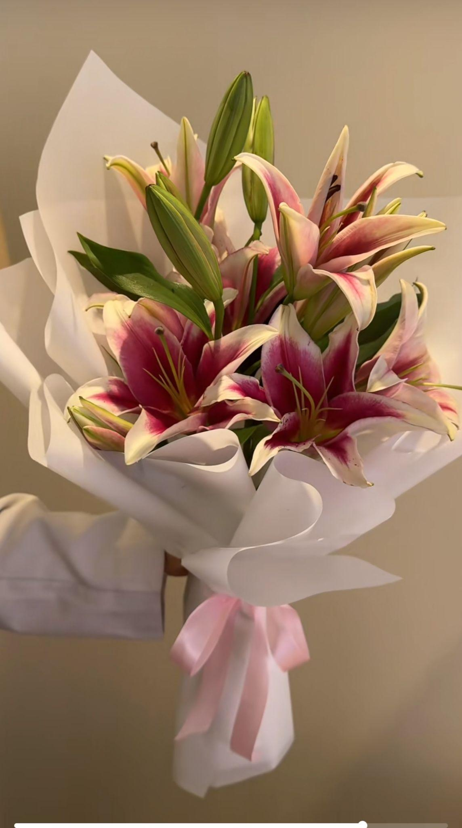
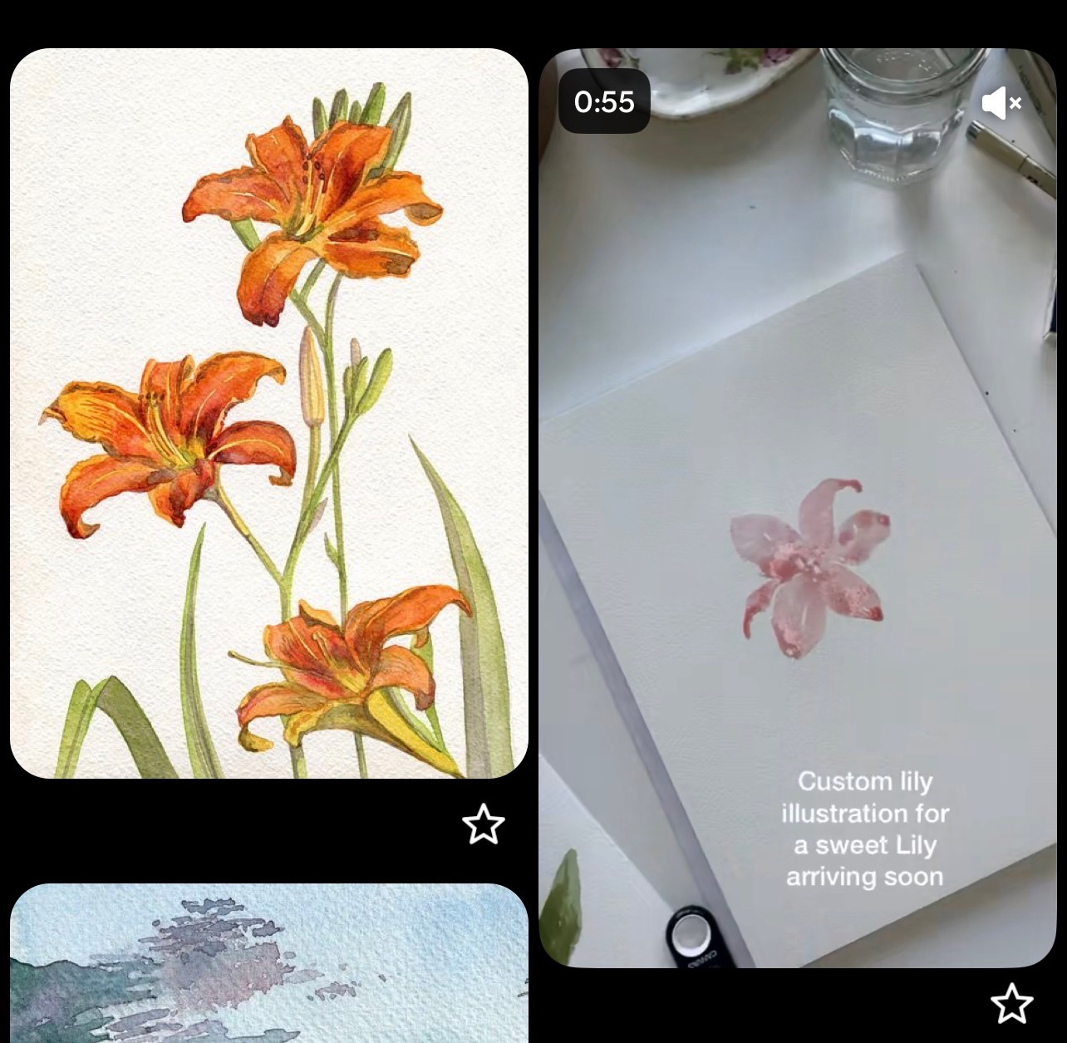
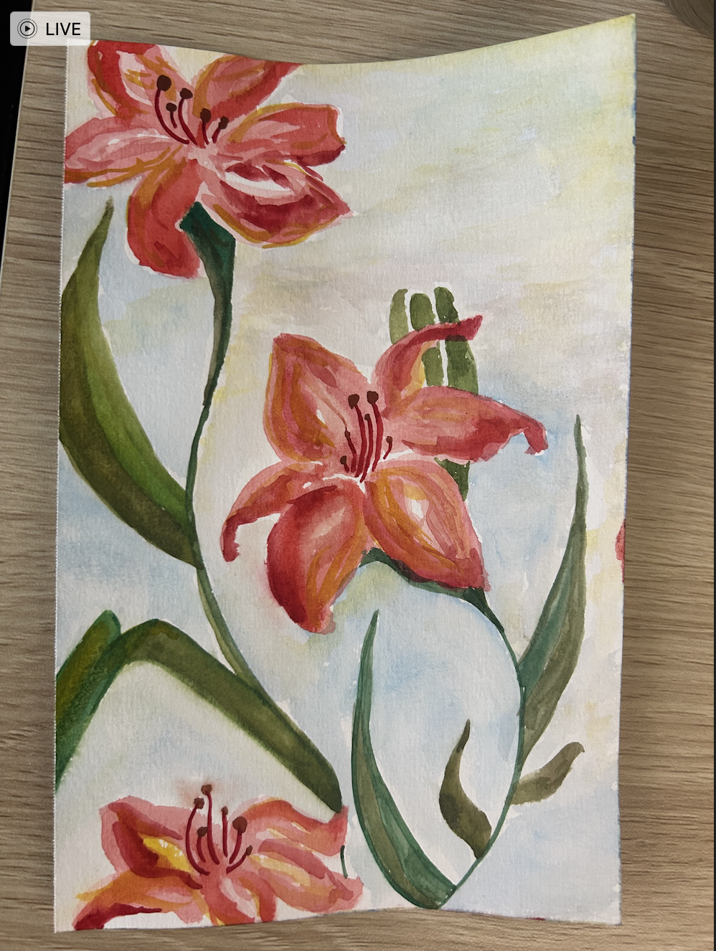
1
2
3
Photos app
Pinterest board from “Watercolor lilies” search
Final piece

Slide 26
Results #2
What worked?
What didn’t?
Assumption
Identifying key words which enabled a unique curation of inspiration sources. She was able to compare and contrast different sources of inspiration through the Pinterest board.
Scrolling through her photos album was tedious as she knew she only wanted to paint natural still life but had a lot of portrait photos to skim through.
Proven (kind of).
She heavily relied on collecting various reference pieces before painting, but found it took too much time to identify the perfect base photo in her library.

Slide 27
#3: HMW make it easier for artists to come back to their old works that they have made over time?
Solution
An archive of past works with smart searching by medium.
Assumption
Labeling each artwork through medium is the most effective way of organizing artist’s artworks
Notes:
For our third HMW, making it easier for artists to come back to the artwork that they have made over time, our solution was to create an archive of their past work and organizing it based on the different types of medium. We are assuming that labeling the artworks through medium is the most effective way to organize the artist’s artworks.

Slide 28
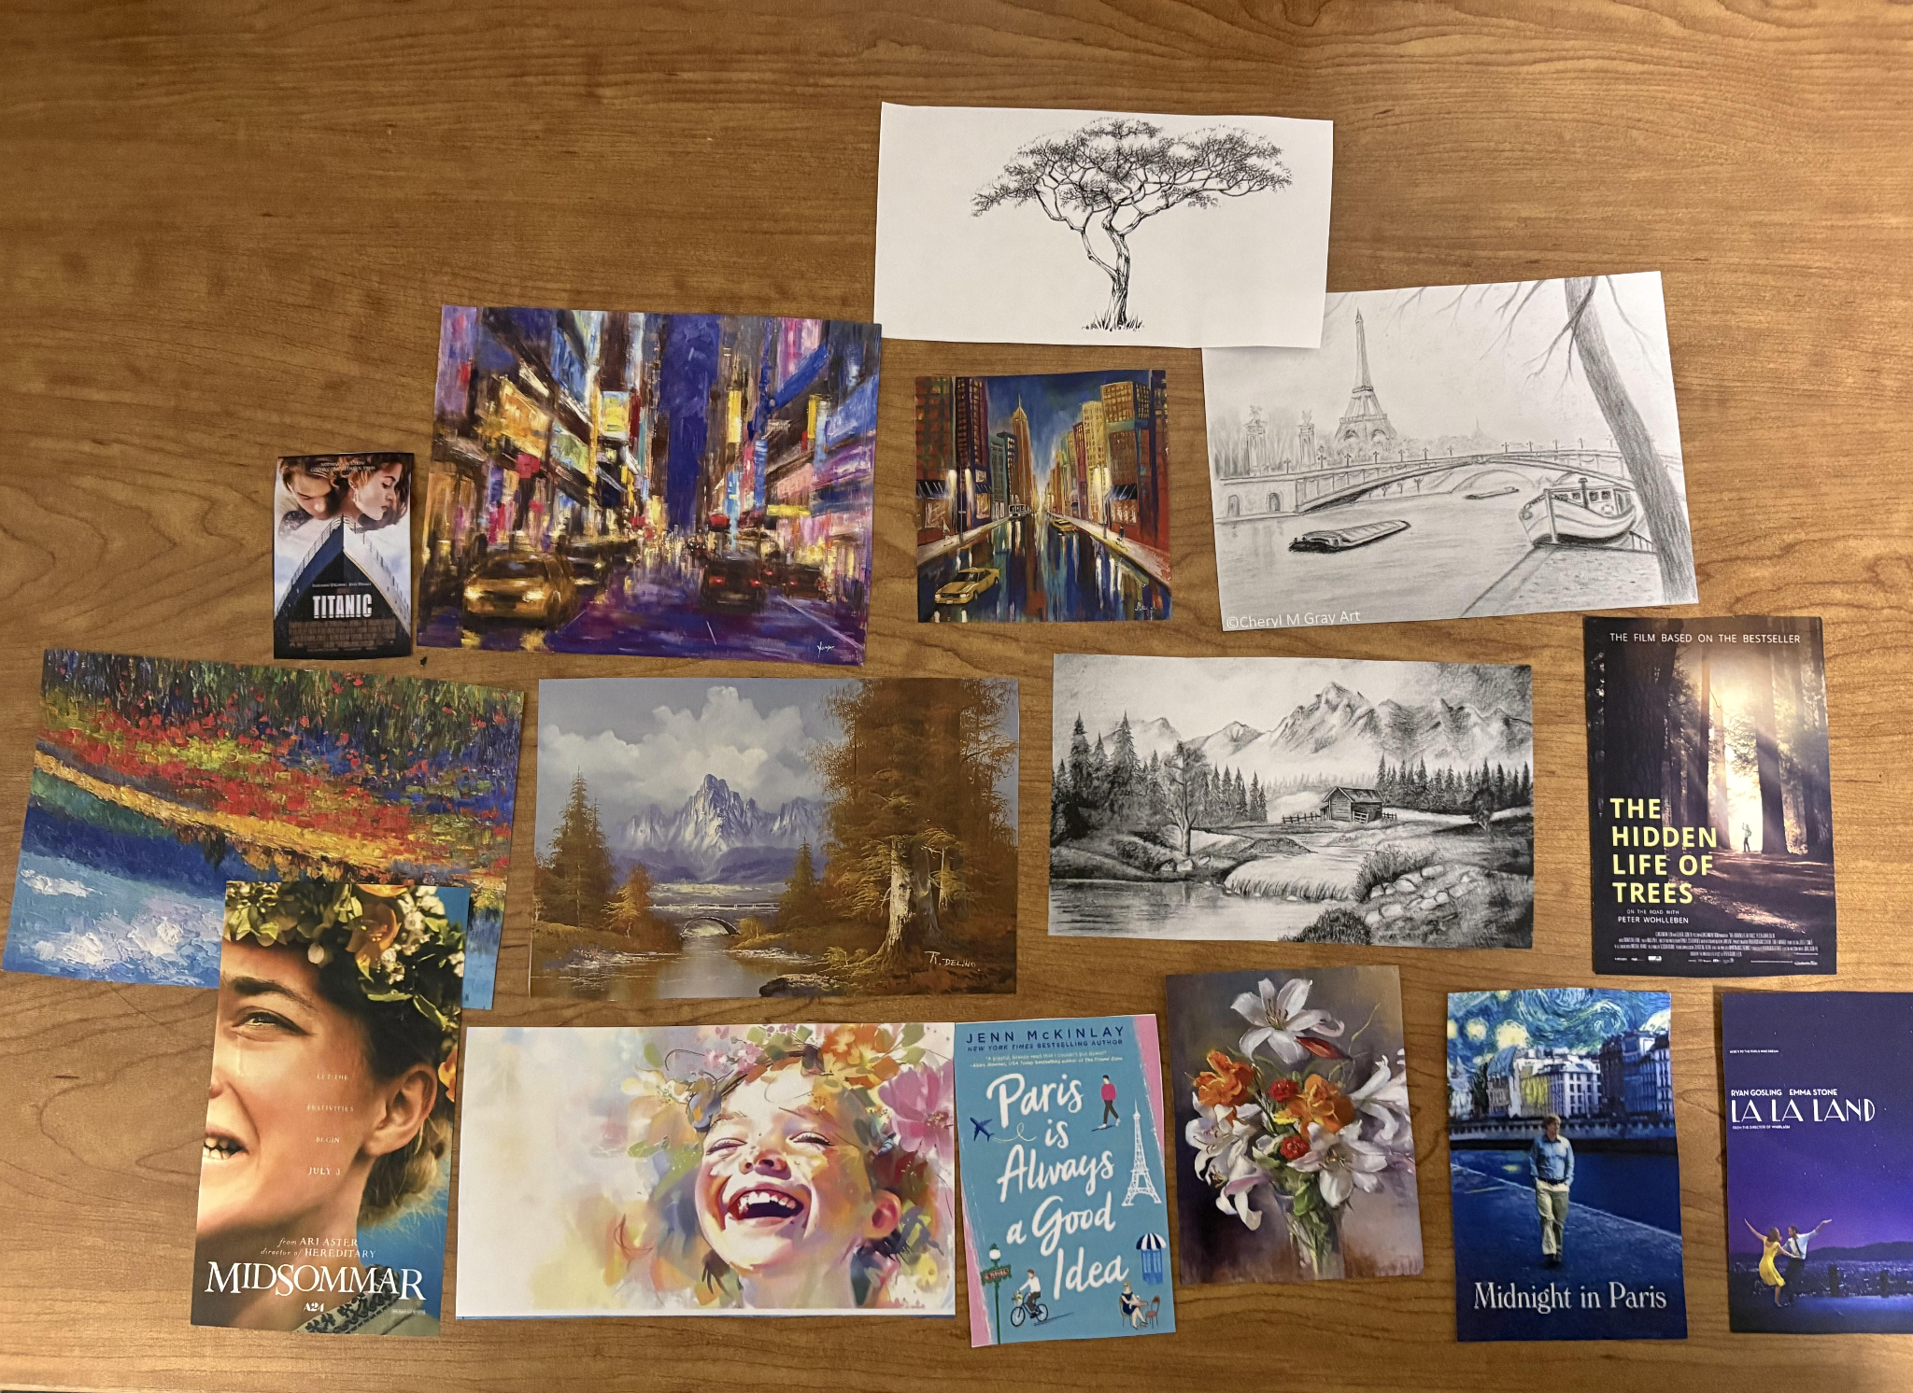
Experience Prototype #3
Who?
Student artists in dorm
What?
Scatter various images randomly and ask the artist to find a picture.
Have them to categorize the images and then find a picture.
Categorize the images by medium and ask them to find a picture.
Notes:
For this experience prototype, we scattered various images randomly and asked for the artist to find a picture. Then, we had them create their own categories and find a picture. Finally we categorized the images by medium (if they hadn’t already done so) and then asked them to find a picture. In each round, we timed their performance.

Slide 29
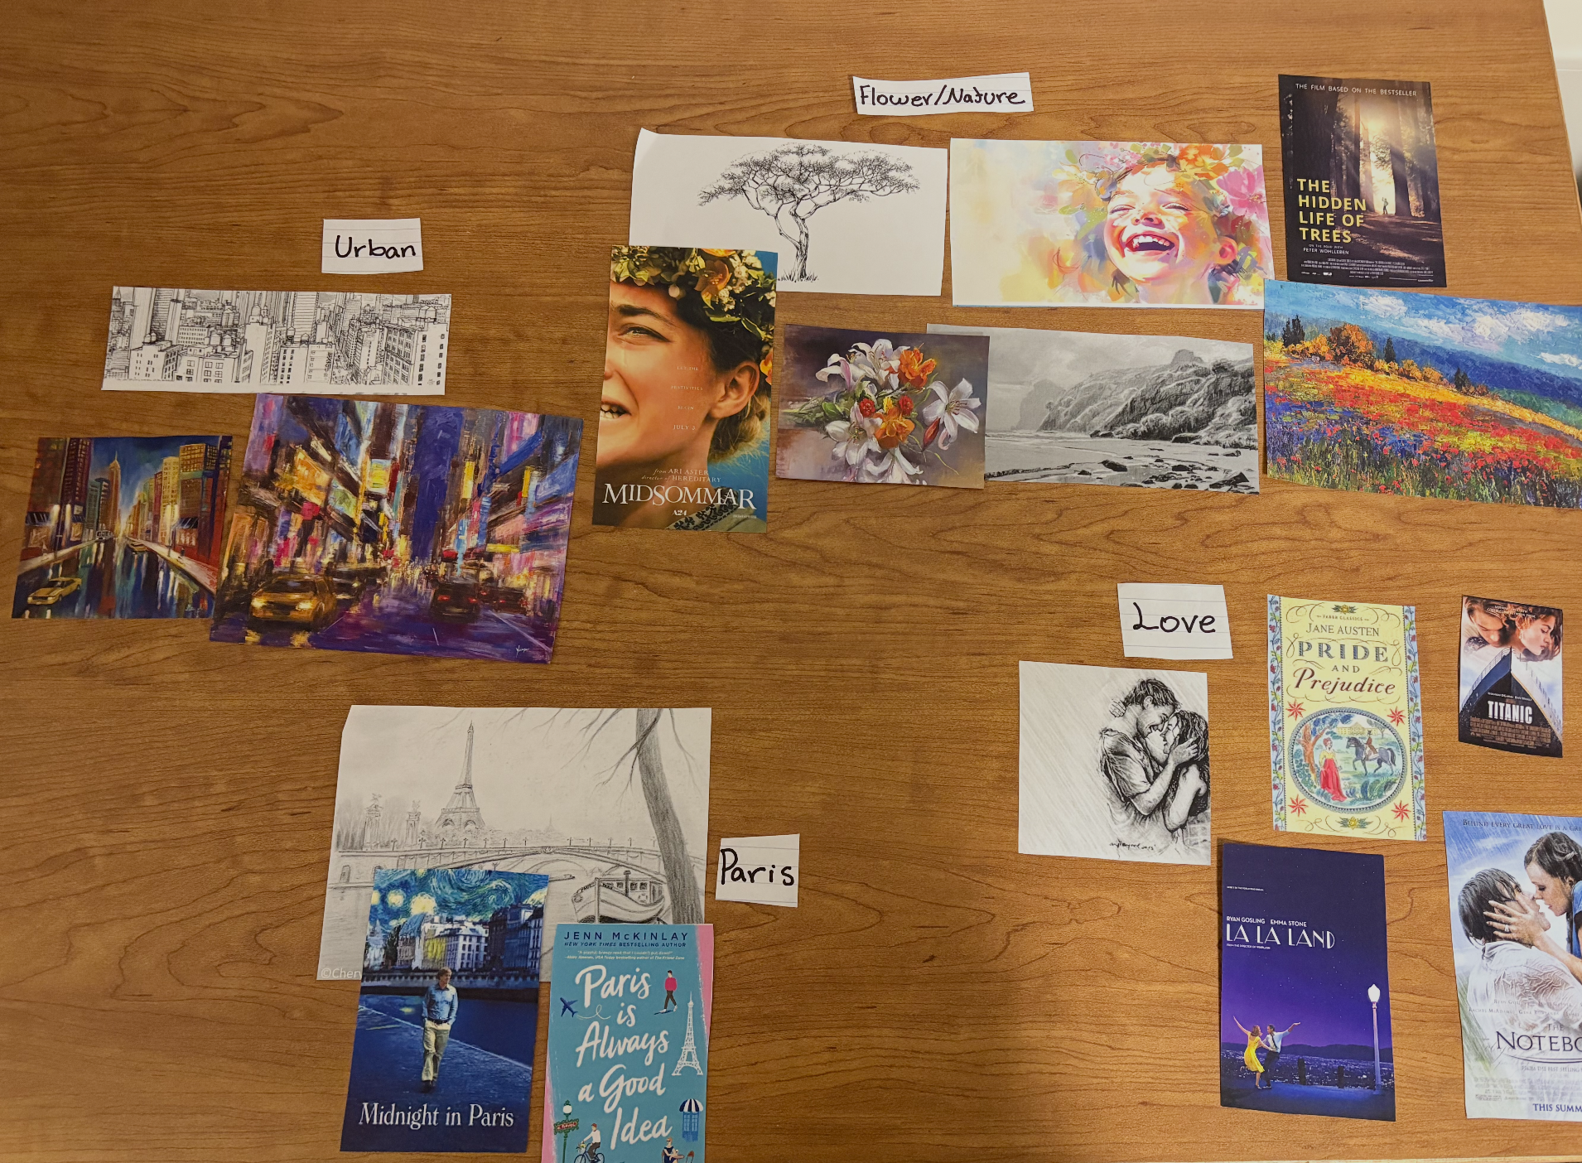
Artist #1
Image organization
Time spent
Random
5.3 s
Their own categories
2.6 s
Medium
3.7 s
Urban
Flower/Nature
Paris
Love

Slide 30
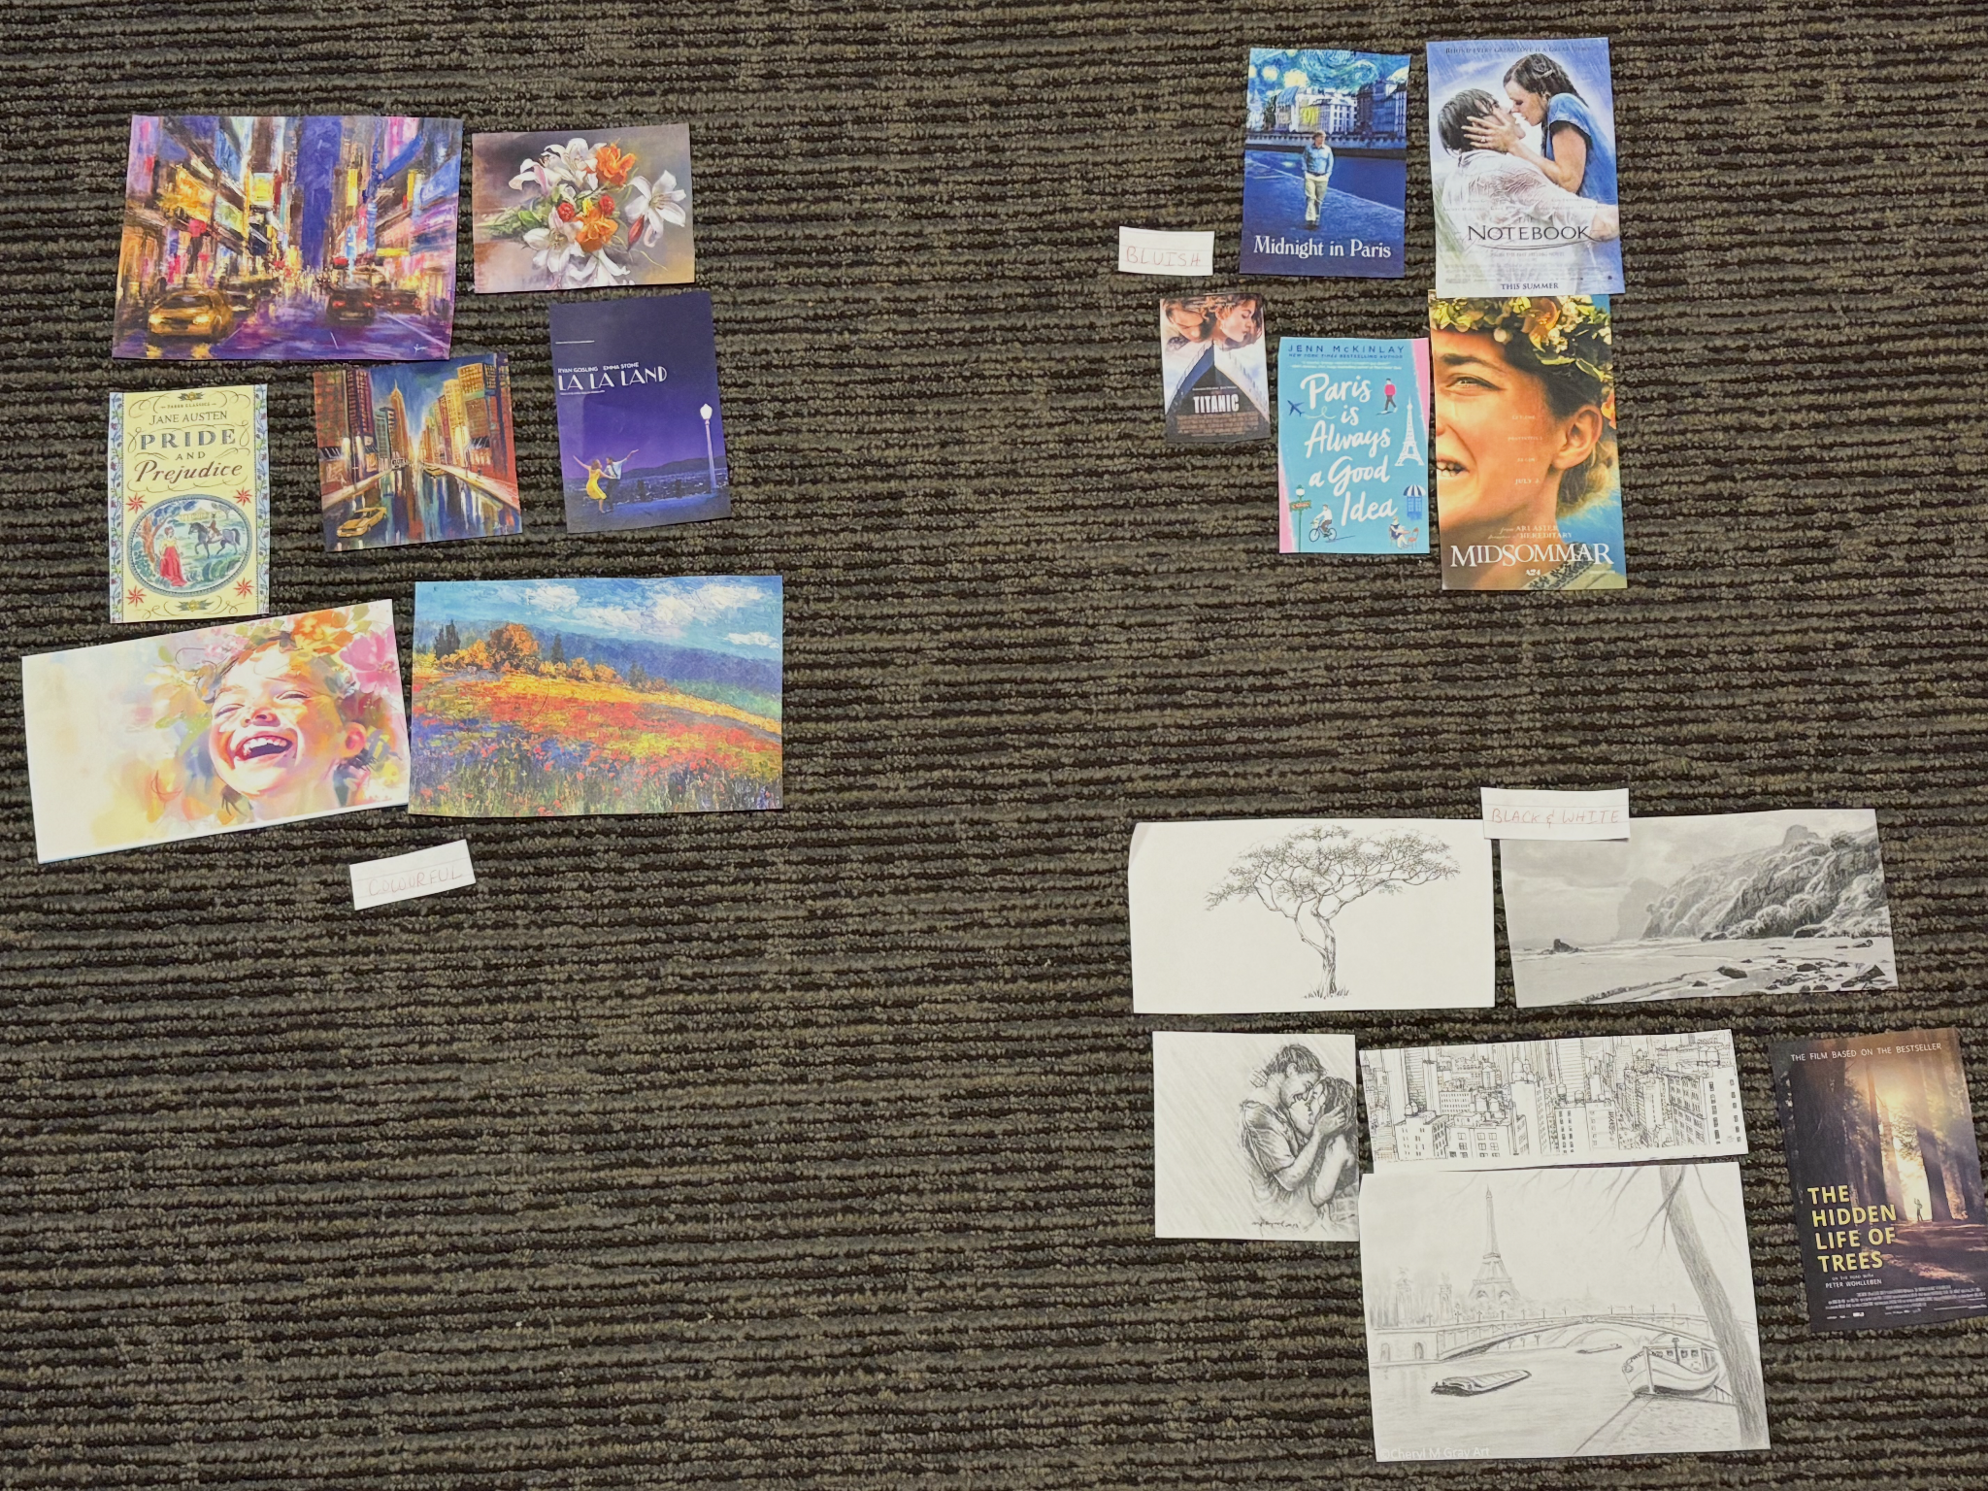
Artist #2
Image organization
Time spent
Random
3.8 s
Their own categories
1.4 s
Medium
1.7 s
Blue
Colorful
Black and White

Slide 31
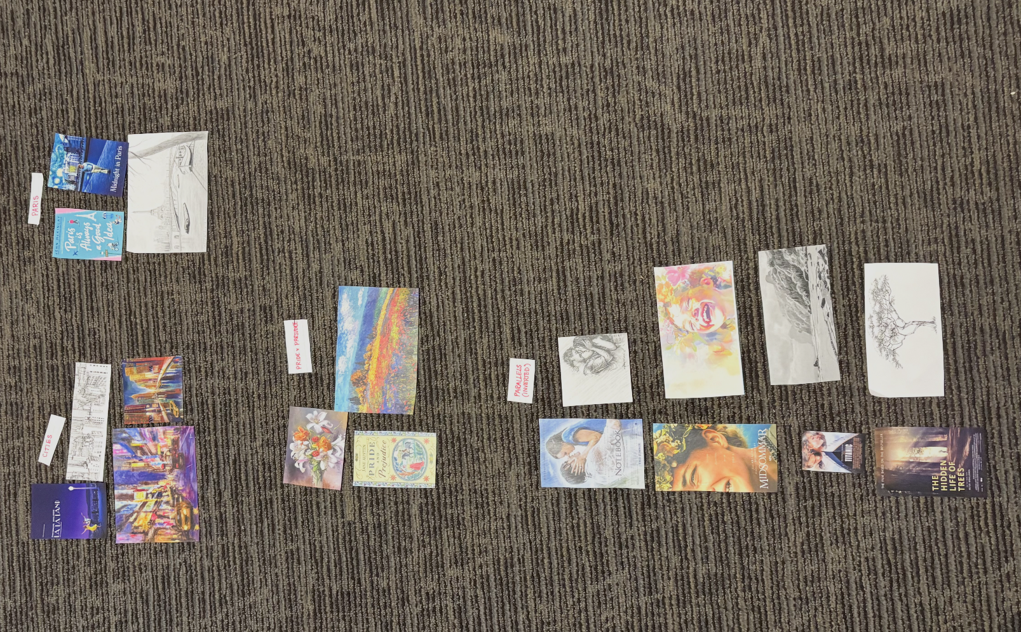
Artist #3
Image organization
Time spent
Random
2.4 s
Their own categories
0.9 s
Medium
1.5 s
Cities
Paris
Pride and Prejudice
Parallels (inverted)

Slide 32
Results #3
What worked?
What didn’t?
Assumption
Users found images faster when it was categorized through medium rather than randomly. They also noted this organization made it easier to identify images.
None of the participants categorized the images through medium. They were also able to find the images faster through their own categorization.
Challenged. While separating the images by mediums made it easier for artists to find them, the results show that it is not the most effective way of categorizing them. Each artist has their unique way of classifying images.

Slide 33
Next Steps
We will mainly be moving with solution #2 but with aspects of 1 and 3.
Ethical implications: making sure everything is properly credited and attributed.
Our solution primarily serves visual artists of all stages.

Slide 34
Thank you!

Slide 35
Appendix

Slide 36
Brainstorming Figjam

Slide 37
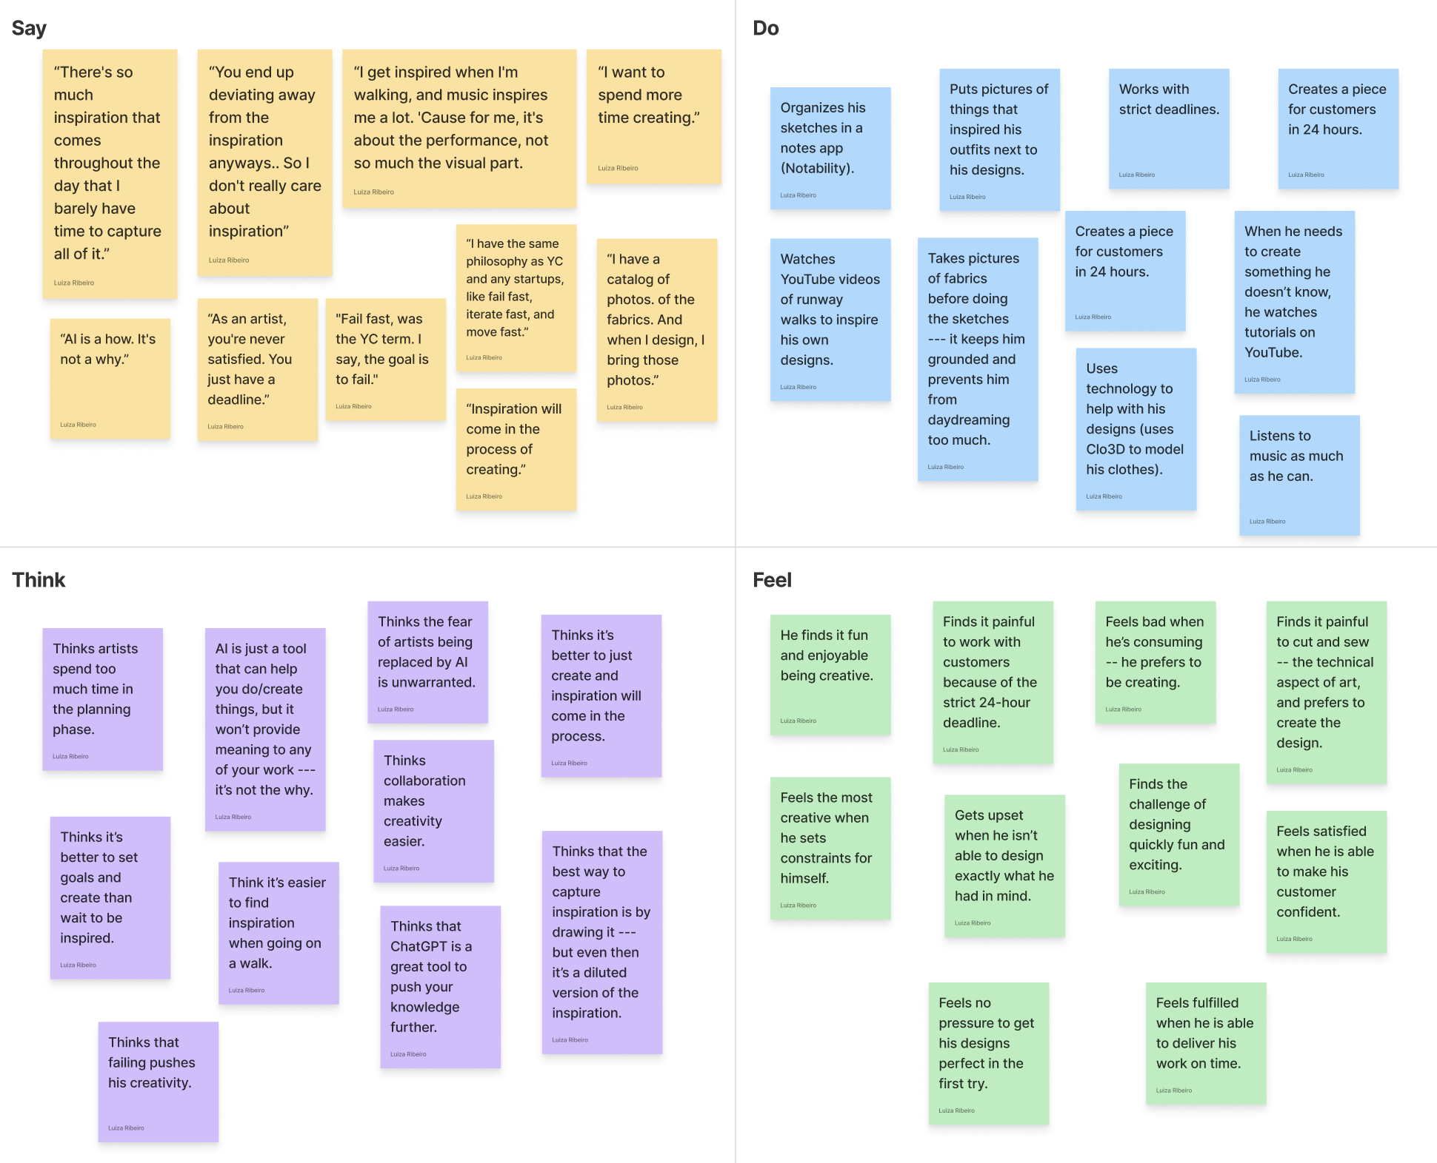
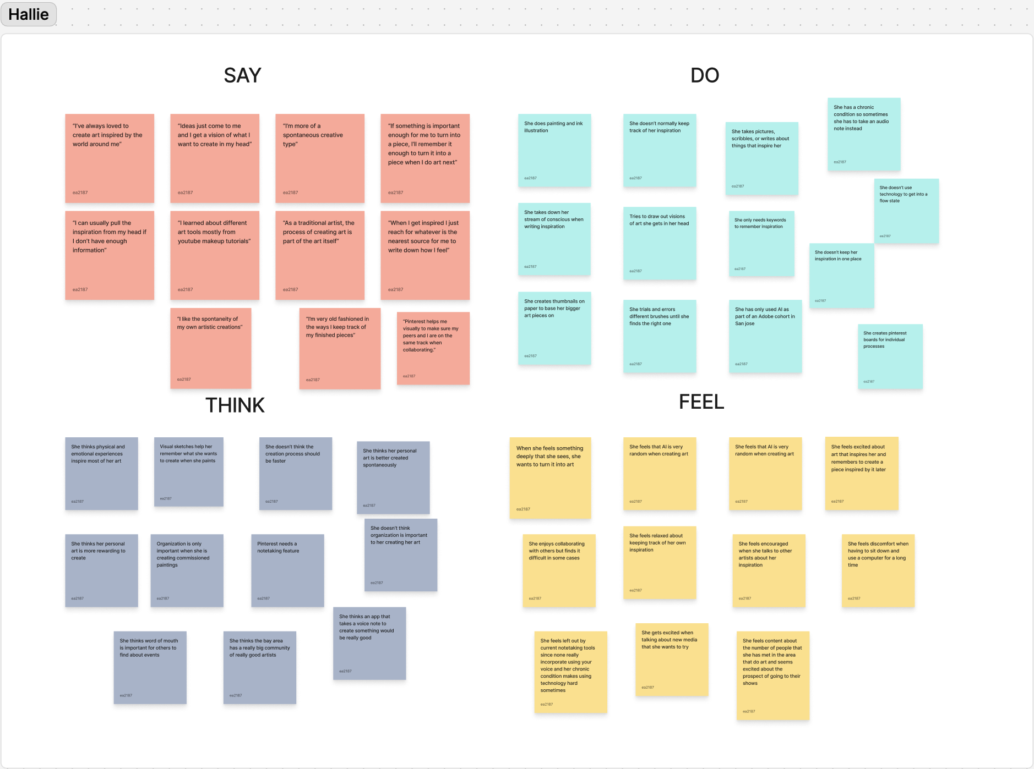
Empathy maps
Fred
Heather

Slide 38
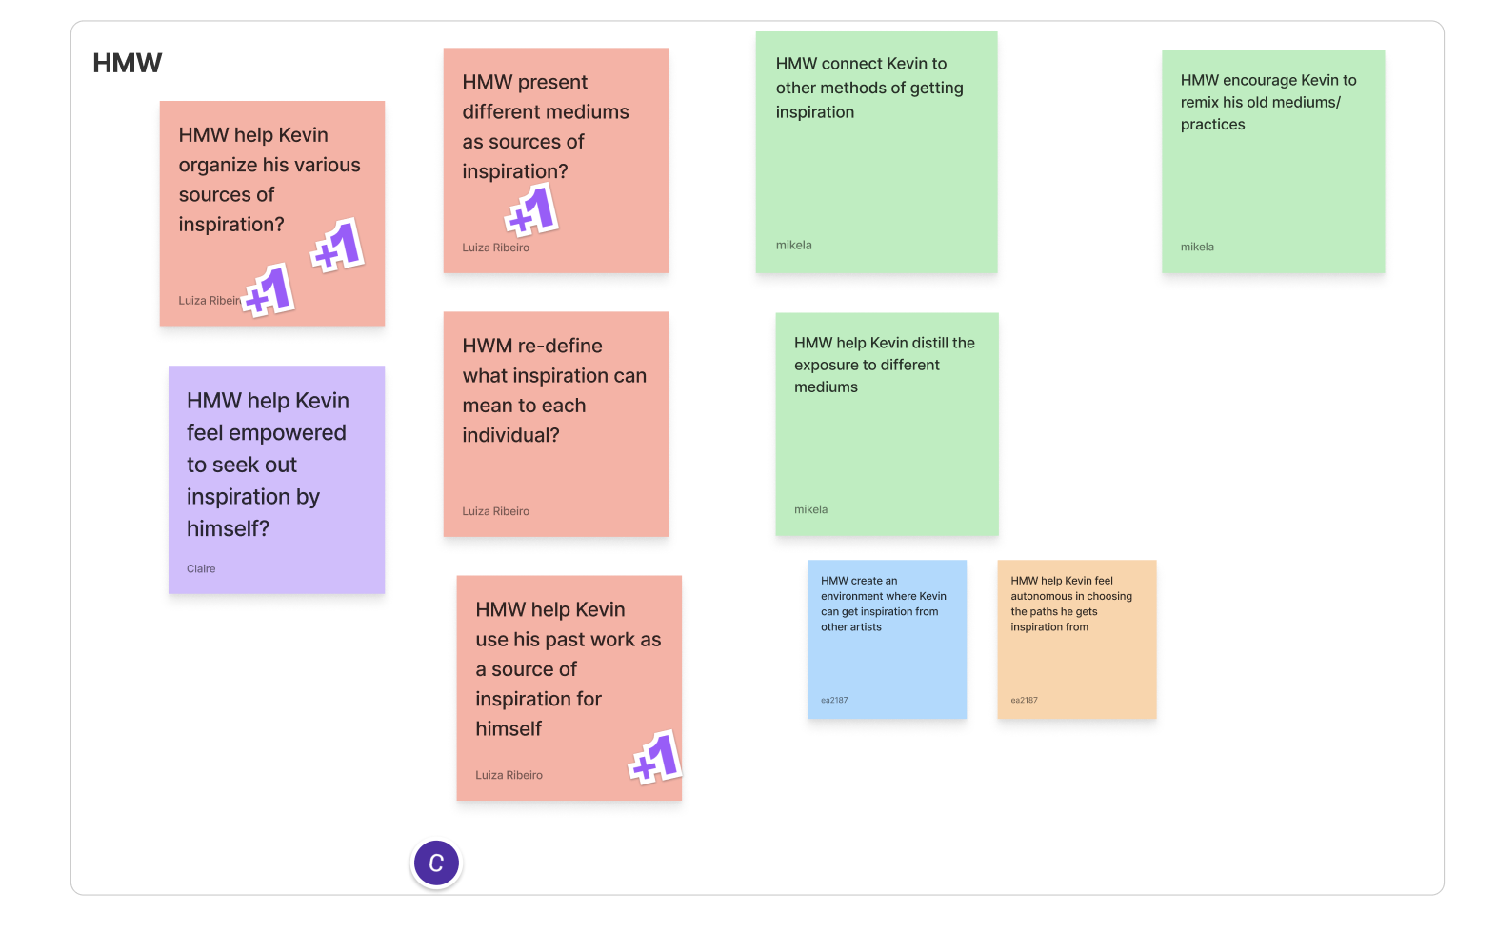
HMW - POV #1

Slide 39
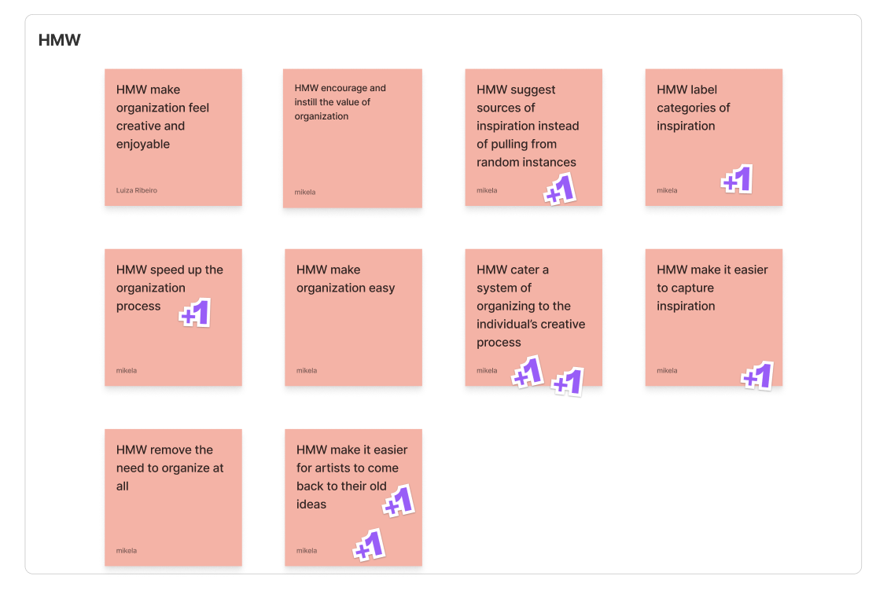
HMW - POV #2

Slide 40
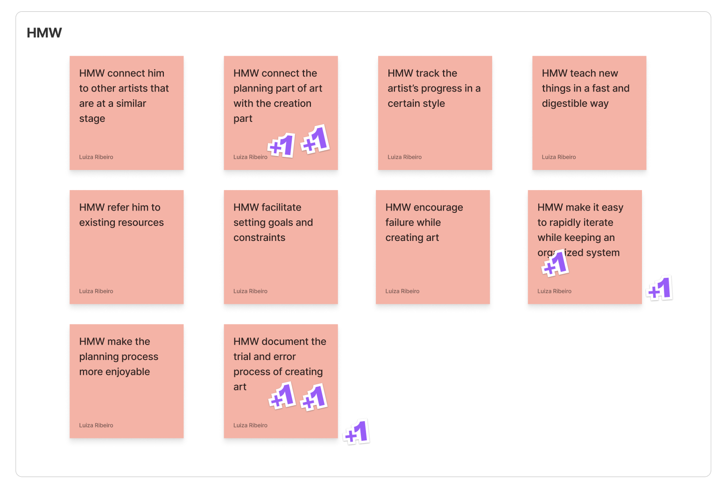
HMW - POV #3

Slide 41
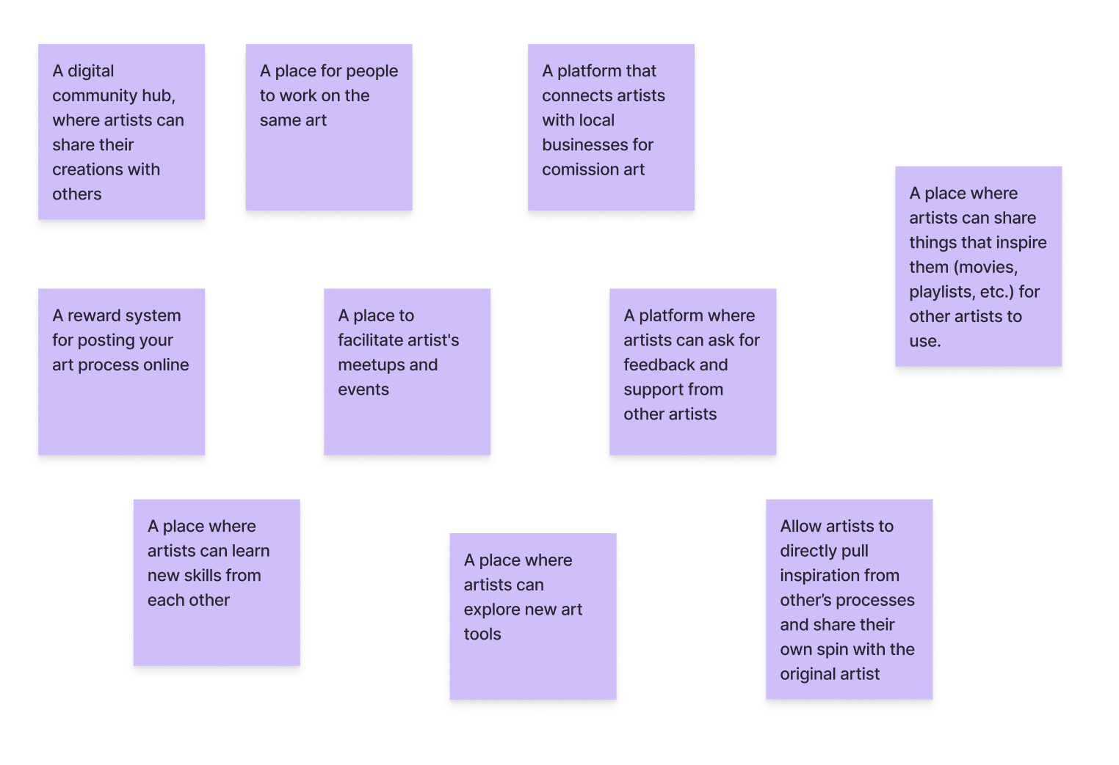
Solutions - POV #1

Slide 42
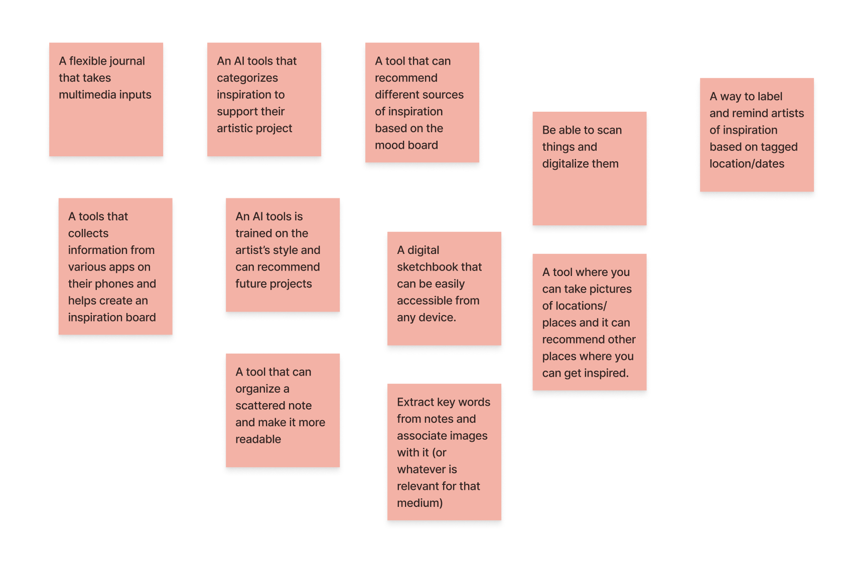
Solutions - POV #2

Slide 43
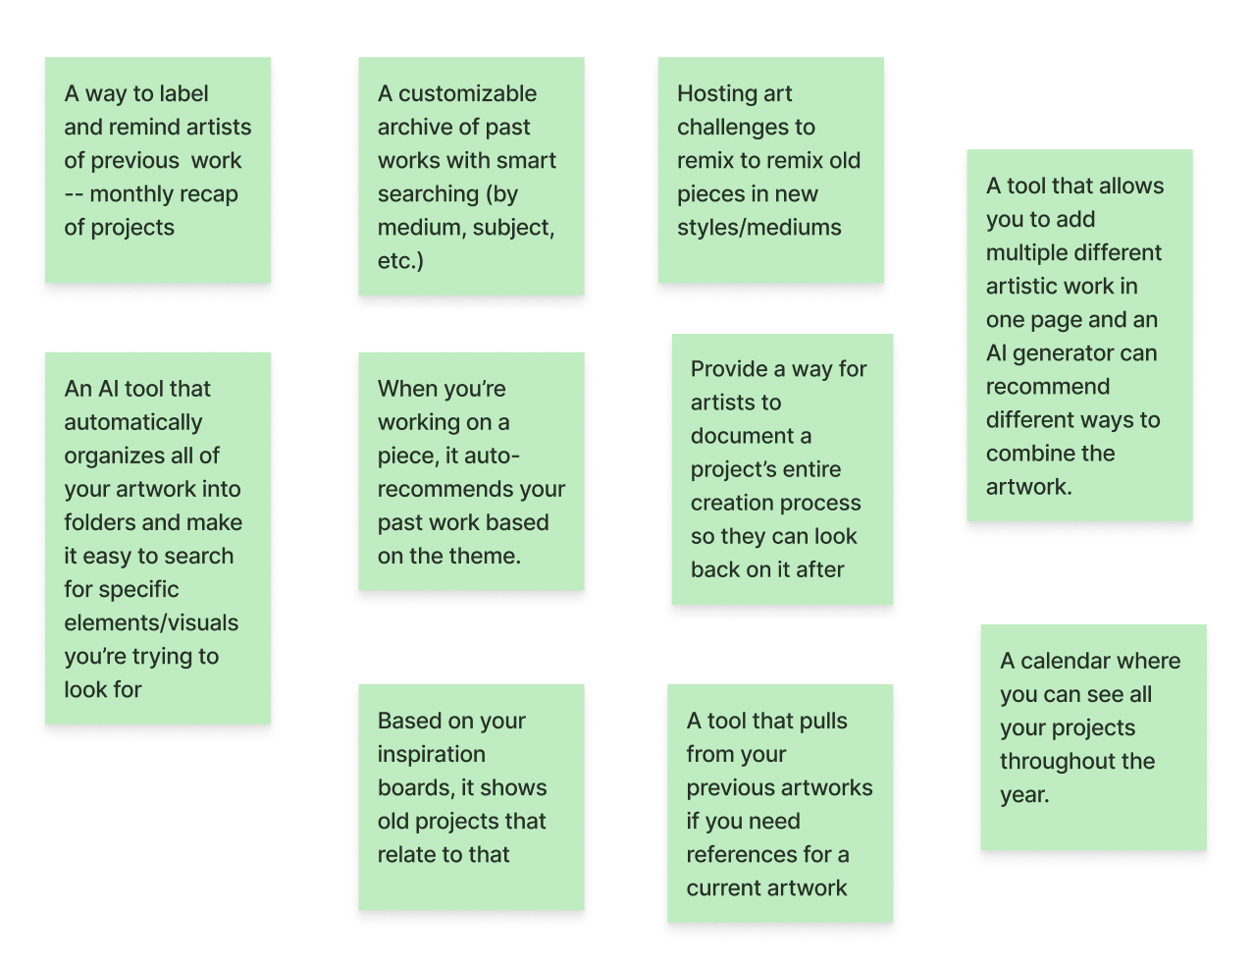
Solutions - POV #3

